Slide 1




Advance Analog and Mixed Signal Design
Lecture 30-32
The g_{m}/I_{D} the real sailor of analog design.
Dr. Neeraj Mishra
High Performance Electronics Lab
Electrical & Electronics Eng. Dept.
Birla Institute of Technology & Science Pilani, Pilani Campus

Slide 2
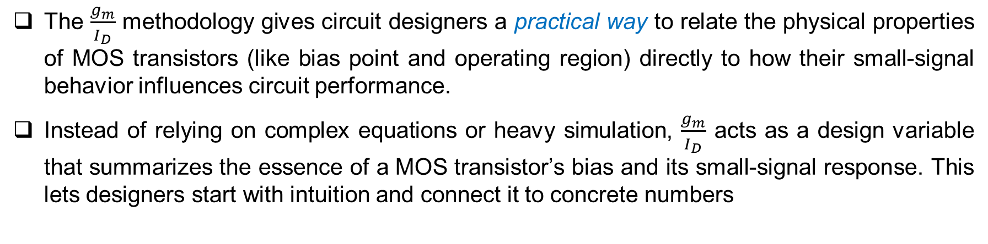
Core Idea of $\frac{g_{m}}{I_{D}}$ Methodology
The $\frac{g_{m}}{I_{D}}$ methodology gives circuit designers a practical way to relate the physical properties of MOS transistors (like bias point and operating region) directly to how their small-signal behavior influences circuit performance.
Instead of relying on complex equations or heavy simulation, $\frac{g_{m}}{I_{D}}$ acts as a design variable that summarizes the essence of a MOS transistor’s bias and its small-signal response. This lets designers start with intuition and connect it to concrete numbers

Slide 3
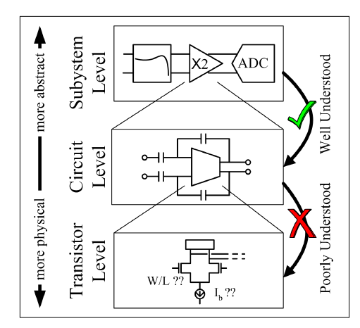
Levels of Abstraction in Analog Design
There are three levels of abstraction involved in analog design:
  Subsystem Level (Top): Highly abstract; designers work with blocks like ADCs or opamps. The internal workings are less important, as long as the block behavior matches an ideal model. This supports system-level design and simulation.
  Circuit Level (Middle): Intermediate abstraction; designers think in terms of how blocks are built from basic circuits such as amplifiers, current mirrors, etc. Here, a designer applies circuit theory and simplified models.
  Transistor Level (Bottom): Lowest abstraction; designers directly manipulate transistor sizes (W/L), choose bias points, and model effects like channel length modulation. Technology details heavily influence performance and modeling.
Low-level circuit implementation is often
more difficult than higher level design
Start at the system level, work down and realize complexity increases.
The vertical arrows in the figure highlight that moving upward, things become more abstract and well understood; moving downward, circuit behavior becomes more concrete but less intuitive—unless you have strong technological and modeling insight.

Slide 4
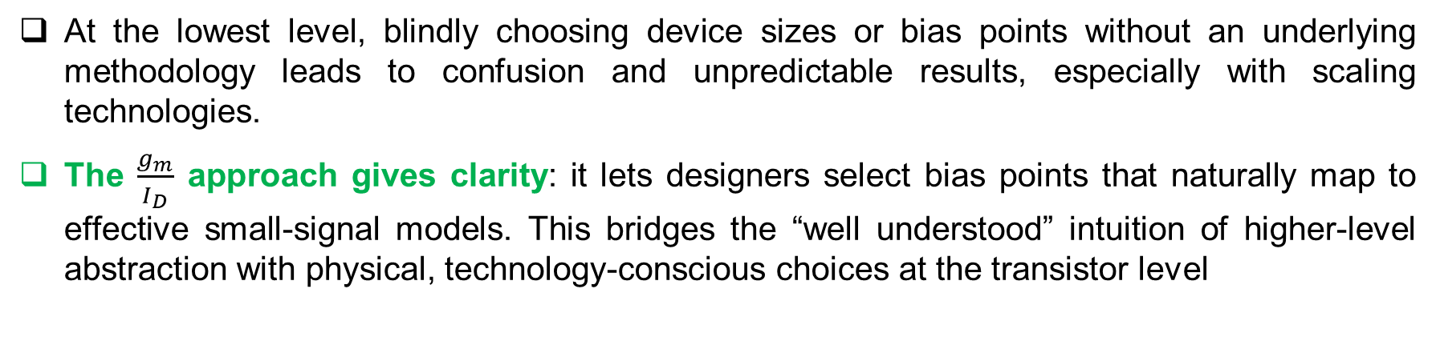
Why $\frac{g_{m}}{I_{D}}$ Matters at the Transistor Level
At the lowest level, blindly choosing device sizes or bias points without an underlying methodology leads to confusion and unpredictable results, especially with scaling technologies.
The $\frac{g_{m}}{I_{D}}$ approach gives clarity: it lets designers select bias points that naturally map to effective small-signal models. This bridges the “well understood” intuition of higher-level abstraction with physical, technology-conscious choices at the transistor level

Slide 5
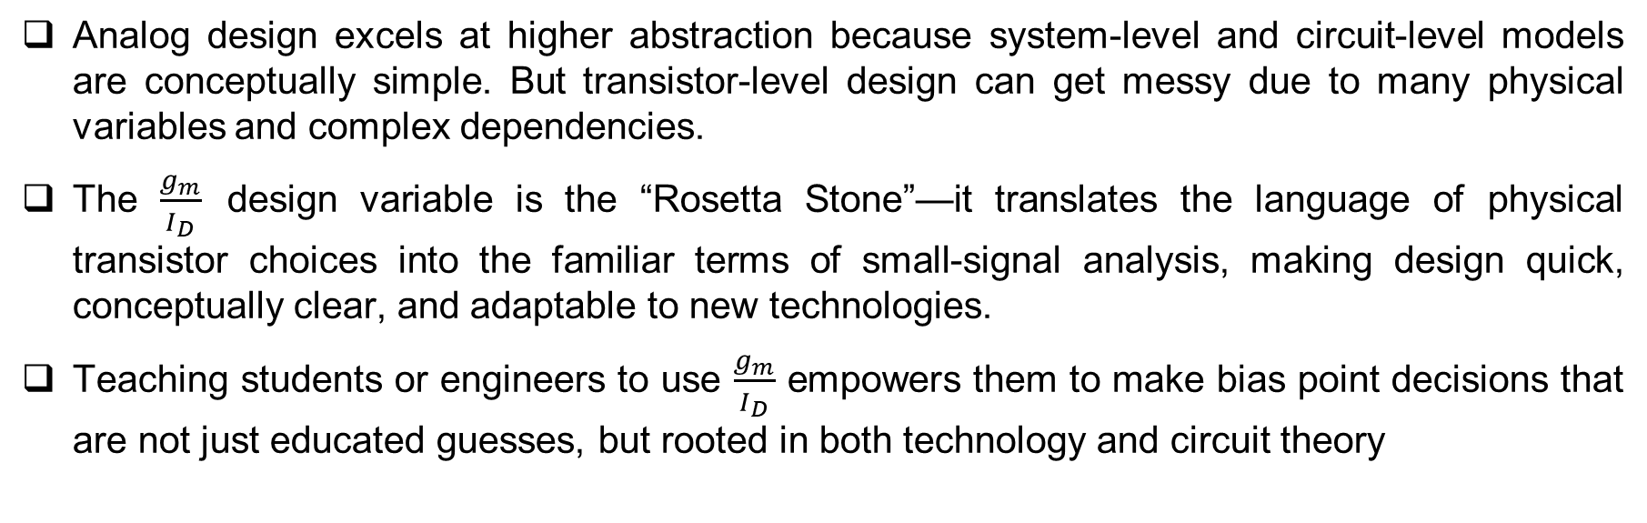
Intuitive Takeaway for a Lecture
Analog design excels at higher abstraction because system-level and circuit-level models are conceptually simple. But transistor-level design can get messy due to many physical variables and complex dependencies.
The $\frac{g_{m}}{I_{D}}$ design variable is the “Rosetta Stone”—it translates the language of physical transistor choices into the familiar terms of small-signal analysis, making design quick, conceptually clear, and adaptable to new technologies.
Teaching students or engineers to use $\frac{g_{m}}{I_{D}}$ empowers them to make bias point decisions that are not just educated guesses, but rooted in both technology and circuit theory

Slide 6
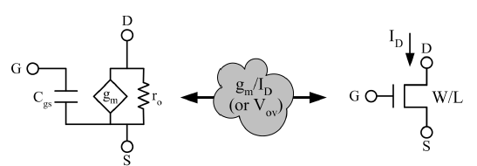
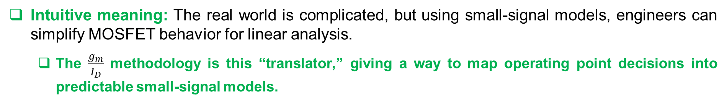
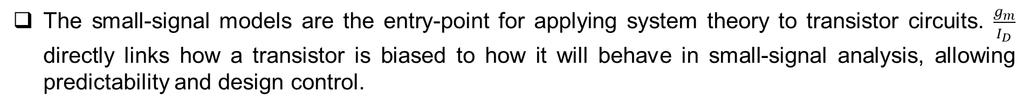
MOS Transistor—From Physical to Small-Signal Model
Use small-signal models as a bridge
Physical MOSFET with terminals; the middle is its small-signal model (with gm, rout, etc.)
The mathematical process or physical insight needed to transition from a real device to its circuit-friendly model.
Intuitive meaning: The real world is complicated, but using small-signal models, engineers can simplify MOSFET behavior for linear analysis.
  The $\frac{g_{m}}{I_{D}}$ methodology is this “translator,” giving a way to map operating point decisions into predictable small-signal models.
The small-signal models are the entry-point for applying system theory to transistor circuits. $\frac{g_{m}}{I_{D}}$ directly links how a transistor is biased to how it will behave in small-signal analysis, allowing predictability and design control.

Slide 7
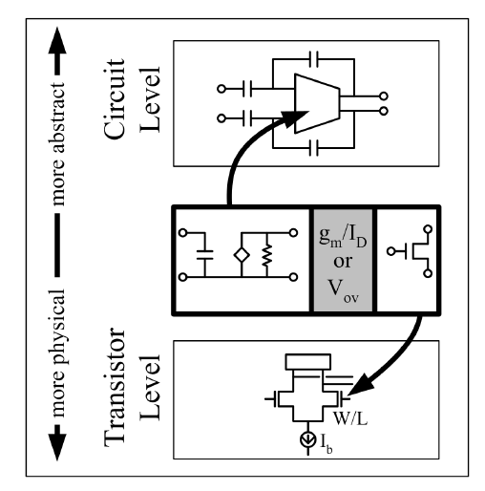
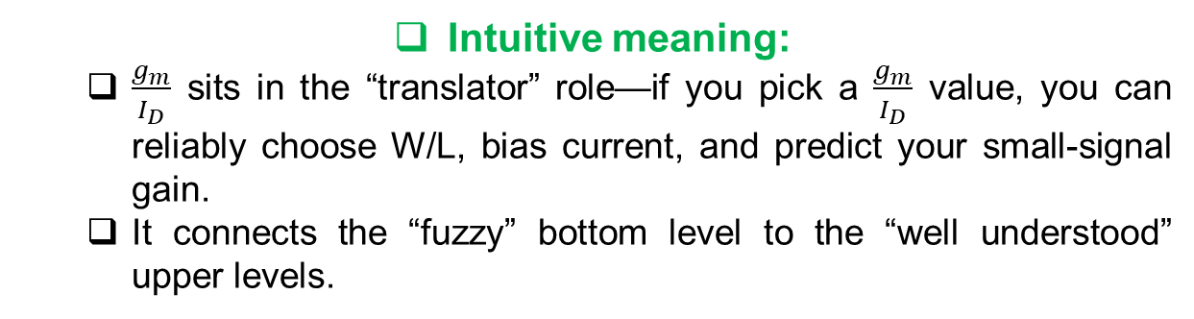
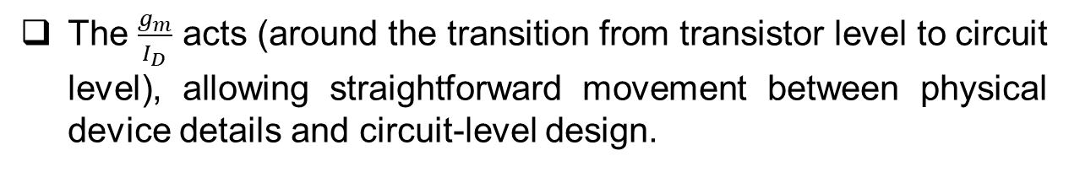
Where $\frac{g_{m}}{I_{D}}$ Fits in the Abstraction Hierarchy
Identify $\frac{g_{m}}{I_{D}}$ as the tool that enables this bridge
The $\frac{g_{m}}{I_{D}}$ acts (around the transition from transistor level to circuit level), allowing straightforward movement between physical device details and circuit-level design.
Intuitive meaning:
  $\frac{g_{m}}{I_{D}}$ sits in the “translator” role—if you pick a $\frac{g_{m}}{I_{D}}$ value, you can reliably choose W/L, bias current, and predict your small-signal gain.
  It connects the “fuzzy” bottom level to the “well understood” upper levels.
Small signal models allow us to use transistors in a Signals-and-Systems context.
Motivation: The $\frac{g_{m}}{I_{D}}$ bridges the gap between technology-centric choices and the designer’s need for abstraction and intuition

Slide 8
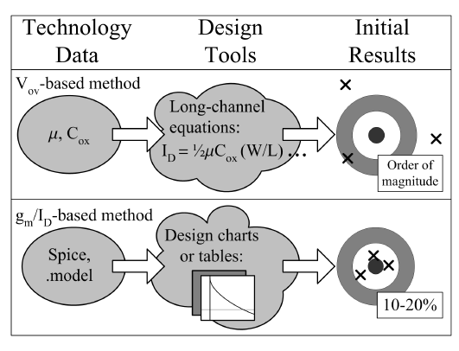
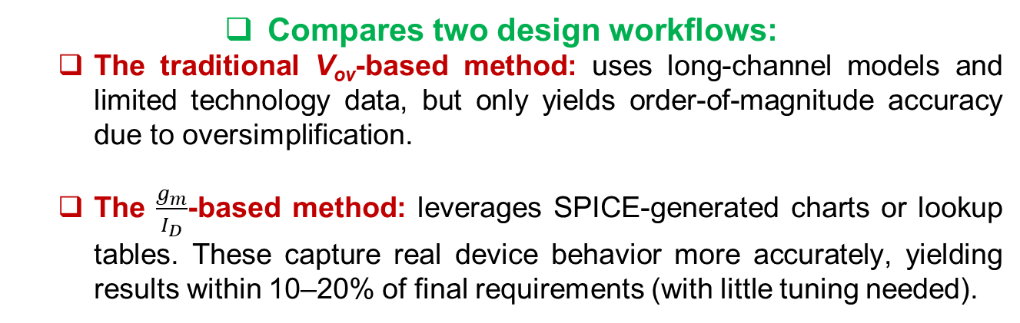
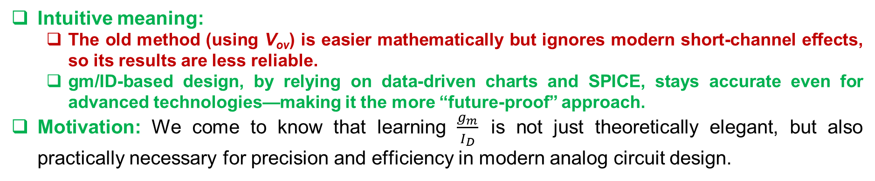
$\frac{g_{m}}{I_{D}}$ vs V_{ov}-Based Design—Which is Better?
Compares two design workflows:
  The traditional V_{ov}-based method: uses long-channel models and limited technology data, but only yields order-of-magnitude accuracy due to oversimplification.
  The $\frac{g_{m}}{I_{D}}$-based method: leverages SPICE-generated charts or lookup tables. These capture real device behavior more accurately, yielding results within 10–20% of final requirements (with little tuning needed).
High-level comparison of two popular design methodologies.
Intuitive meaning:
  The old method (using V_{ov}) is easier mathematically but ignores modern short-channel effects, so its results are less reliable.
  gm/ID-based design, by relying on data-driven charts and SPICE, stays accurate even for advanced technologies—making it the more “future-proof” approach.
Motivation: We come to know that learning $\frac{g_{m}}{I_{D}}$ is not just theoretically elegant, but also practically necessary for precision and efficiency in modern analog circuit design.

Slide 9
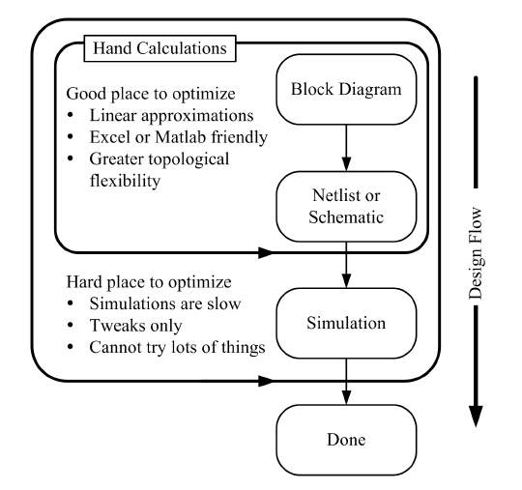
Stepwise Flow—From Hand Calculations to Simulation
Hand Calculations to Simulation two main phases:
The inner loop ("Hand Calculations") where most creative and effective optimization occurs.
The outer loop ("Simulation and Tweaking"), which is slow and less effective for broad exploration.
We can do more effective optimization in the hand-calculations phase than in the simulations phase of the design process.

Slide 10
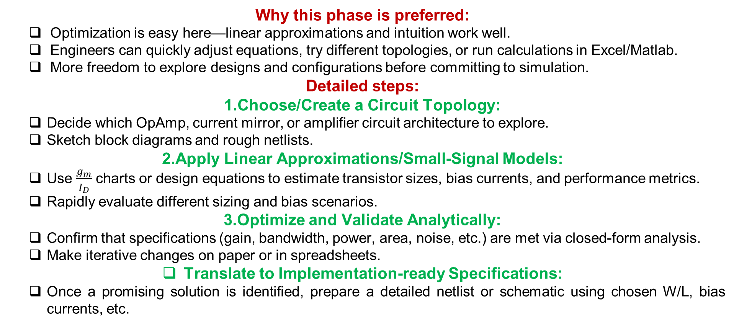
Inner Loop: Hand Calculations
Why this phase is preferred:
  Optimization is easy here—linear approximations and intuition work well.
  Engineers can quickly adjust equations, try different topologies, or run calculations in Excel/Matlab.
  More freedom to explore designs and configurations before committing to simulation.
Detailed steps:
Choose/Create a Circuit Topology:
  Decide which OpAmp, current mirror, or amplifier circuit architecture to explore.
  Sketch block diagrams and rough netlists.
Apply Linear Approximations/Small-Signal Models:
  Use $\frac{g_{m}}{I_{D}}$ charts or design equations to estimate transistor sizes, bias currents, and performance metrics.
  Rapidly evaluate different sizing and bias scenarios.
Optimize and Validate Analytically:
  Confirm that specifications (gain, bandwidth, power, area, noise, etc.) are met via closed-form analysis.
  Make iterative changes on paper or in spreadsheets.
Translate to Implementation-ready Specifications:
  Once a promising solution is identified, prepare a detailed netlist or schematic using chosen W/L, bias currents, etc.

Slide 11
Outer Loop: Simulation and Tuning
Why this phase is challenging:
  SPICE simulations are time-consuming and limited in scope.
  Each run only allows minor parameter tweaks; cannot broadly explore topologies or sizing.
  "Spice Monkeying"—blind, iterative tweaking—wastes time and erodes design intuition.
Typical steps and their pitfalls:
  Guess initial W/L, R, C values.
  Simulate the design in SPICE.
  Check if all specs are met.
  If not, adjust W/L, R, C (repeat).
  Note: This loop tends to be slow, non-intuitive, and risk missing creative or optimal solutions.
Best practice:
Always push as many decisions and optimizations as possible into the hand calculations phase, where understanding, flexibility, and speed are maximized. Use simulation to verify and fine-tune, never as the sole method for decision-making.

Slide 12
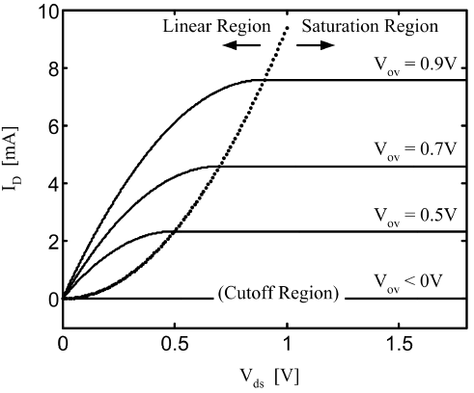
MOSFET Biasing—Operating Regions
In the saturation region, ID is primarily a function of Vgs.
What I_{D} v/s V_{DS} curve tell us?
Plots I_{D} (drain current) vs. V_{DS} (drain-source voltage) for various fixed values of V_{ov} (overdrive voltage).
The plot is divided into three classical regions:
  Cutoff Region
  Linear (Triode) Region
  Saturation Region
Cutoff Region
Condition: V_{ov}<0 (i.e., V_{gs}<V_{T})
Behavior: Transistor is OFF, no inversion layer has formed, so I_{D}=0.
Intuitive point: The gate voltage isn't high enough to turn the MOSFET on—no current flows

Slide 13


Cont..
Linear (Triode) Region
Condition: V_{ov} ≥ 0 and V_{ds}< V_{sat} (not fully pinched-off)
Behavior: The Transistor acts as a voltage-controlled resistor. Current is determined by both V_{ds} and V_{ov}:
  Intuitive point: MOSFET can pass current, but how much depends linearly on V_{ds} for small values (hence "linear region").
You can also define ON-resistance:
Useful for switches (digital logic, switched-cap circuits)

Slide 14
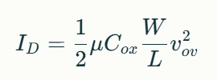
Cont..
Saturation Region
  Condition: V_{ov}≥0 and V_{ds}≥V_{sat}
  Behavior: Channel pinches off near drain, current depends only on gate voltage (not on V_{ds}):
  Intuitive point: Most analog building blocks (amplifiers, active loads) operate here for predictability—the gate voltage alone sets the current.

Slide 15
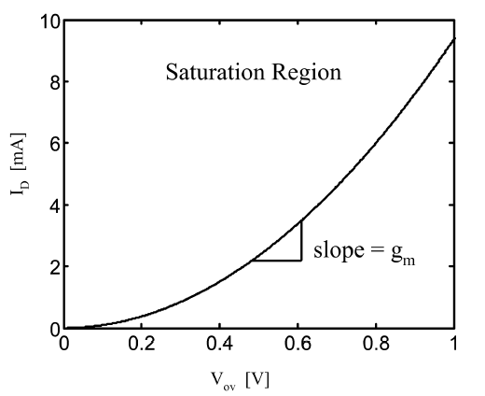
Saturation-centric Transistor Biasing
A saturation-centric view of transistor biasing.
Motivation:
I_{D} vs. V_{ov} in the saturation region, emphasizing quadratic relationship and showing that the slope at any V_{ov} is g_{m} (transconductance).
Saturation region is crucial for analog design (except switches).
As V_{ov} increases:
  I_{D} increases quadratically.
  g_{m}—the slope—even increases with V_{ov}, indicating a stronger, more sensitive device.
Key Intuitive Takeaways:
  Biasing in saturation gives precise control over current based solely on gate voltage.
  Gives a direct link: choose V_{ov} via gate bias, get predictable I_{D} and g_{m}, which are the backbone of analog performance

Slide 16
Overdrive Voltage—A Fundamental Variable
Definition:
V_{ov}=V_{gs}−V_{T}
Intuitive meaning: Measures how far above threshold the gate voltage is—i.e., how "ON" the transistor really is.
Inversion: Weak inversion (very small V_{ov}) gives subthreshold conduction (leakage, ultra-low currents); strong inversion (large V_{ov}) gives robust ON state.
V_{ov} acts as a practical design variable: easy to work with, hides V_{T} variations, and maps directly to device "strength" (from weak to strong conduction).

Slide 17
Motivation: Why Use V_{ov} in Transistor Design?
In analog design, choosing good transistor sizes and bias points is crucial—these choices directly impact gain, bandwidth, noise, and power consumption.
However, parameters like threshold voltage (V_{T}), mobility, or oxide capacitance (C_{ox}) are either fixed by process or hard to control directly by the designer.
The overdrive voltage (V_{ov}=V_{gs}−V_{T}) is a key variable because:
  It tells us how strongly a MOSFET channel is "inverted" (how well it conducts).
  It is easy to work with—it hides dependence on V_{T} and allows focus on how "ON" the device actually is.
  Higher V_{ov} means stronger inversion (robust ON behavior), while lower V_{ov} is weak inversion (subthreshold/leakage).
By treating V_{ov} as a design "knob"—something that can be tuned—we turn a complex physics problem into a manageable engineering task.

Slide 18
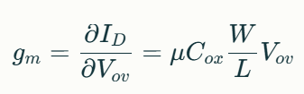
The Role of g_{m}: Connecting Small-Signal Performance to Biasing
Transconductance (g_{m}) is a vital small-signal parameter—it controls the gain and speed of most analog blocks.
gm is defined as the rate at which the drain current (I_{D}) changes with gate voltage, or in our new framework, with overdrive voltage:
Intuitive point: g_{m} grows linearly with V_{ov} (in long-channel), so by choosing a bias point, you set both DC current and small-signal gain

Slide 19
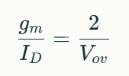
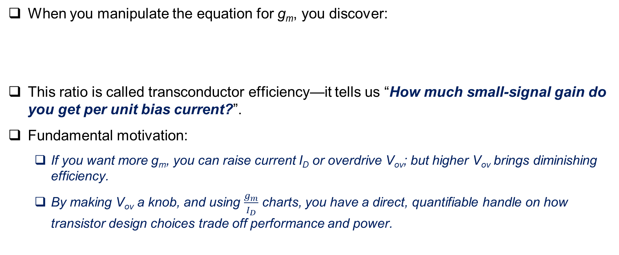
Linking g_{m}, I_{D}, and $\frac{g_{m}}{I_{D}}$ Ratio: Physical Meaning
When you manipulate the equation for g_{m}, you discover:
This ratio is called transconductor efficiency—it tells us “How much small-signal gain do you get per unit bias current?”.
Fundamental motivation:
  If you want more g_{m}, you can raise current I_{D} or overdrive V_{ov}; but higher V_{ov} brings diminishing efficiency.
  By making V_{ov} a knob, and using $\frac{g_{m}}{I_{D}}$ charts, you have a direct, quantifiable handle on how transistor design choices trade off performance and power.

Slide 20
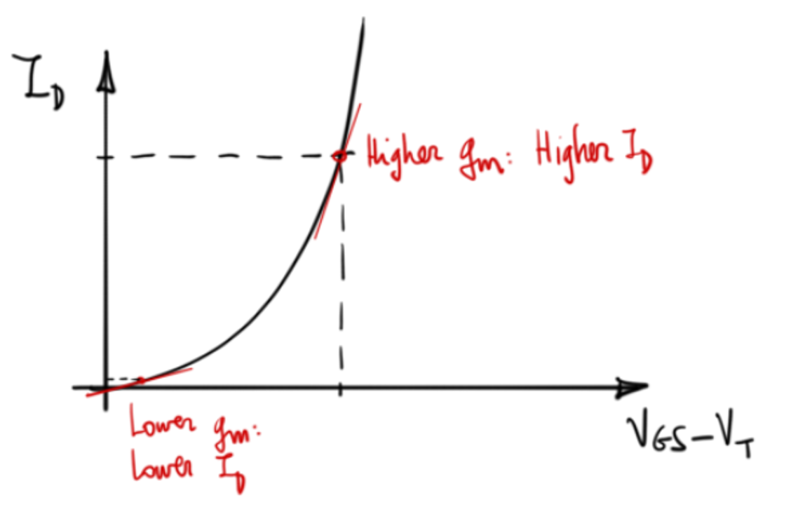
Why Do We Talk About $\frac{g_{m}}{I_{D}}$ in Analog Design?
Square Law Analogy:
Imagine your transistor as a machine.
To get more output (signal control: g_{m}), you must put in more fuel (current: I_{D}).
  At low “throttle” (low V_{gs}–V_{t}), the machine is lazy: you spend a lot of fuel for little effect (low gm, inefficient).
  At high “throttle,” the machine is lively: you get more effect for each bit of fuel (high g_{m}, efficient).
Steep slope = every bit of fuel buys you a lot of push (high g_{m}/I_{D})
Output “push” (I_{D})
Input “throttle” (V_{gs}–V_{t})

Slide 21
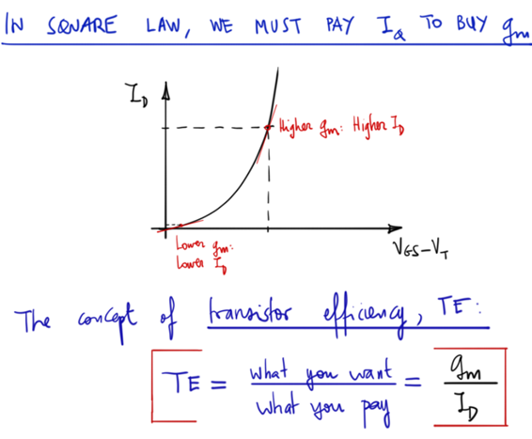
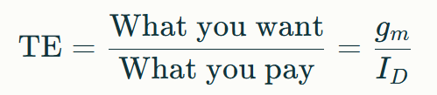
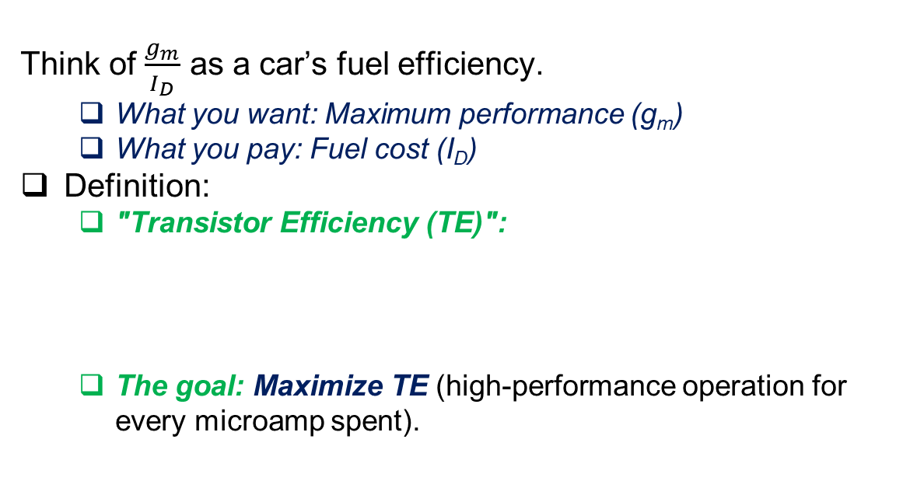
Transistor Efficiency – The $\frac{g_{m}}{I_{D}}$ Concept
Efficiency Analogy:
Think of $\frac{g_{m}}{I_{D}}$ as a car’s fuel efficiency.
  What you want: Maximum performance (g_{m})
  What you pay: Fuel cost (I_{D})
Definition:
  "Transistor Efficiency (TE)":
  The goal: Maximize TE (high-performance operation for every microamp spent).

Slide 22
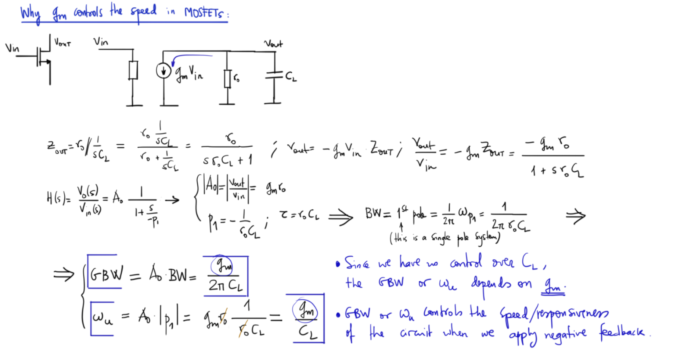
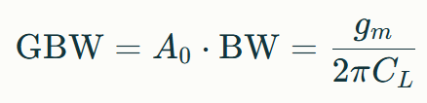
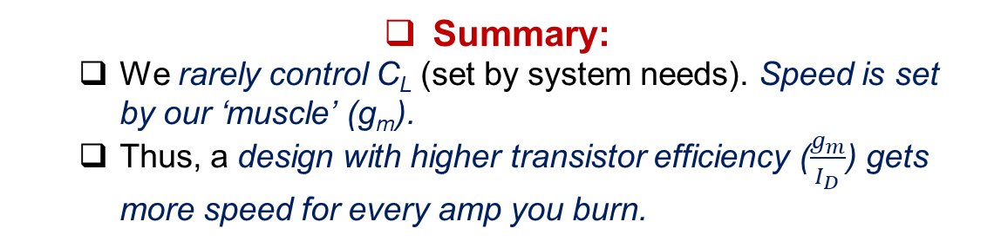
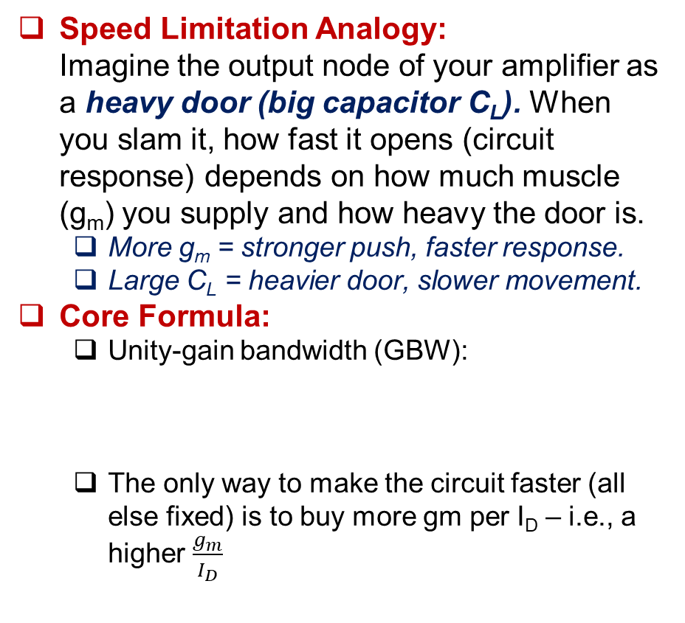
Why Does g_{m} Control Speed? (The Bandwidth Analogy)
Speed Limitation Analogy:
Imagine the output node of your amplifier as a heavy door (big capacitor C_{L}). When you slam it, how fast it opens (circuit response) depends on how much muscle (g_{m}) you supply and how heavy the door is.
  More g_{m} = stronger push, faster response.
  Large C_{L} = heavier door, slower movement.
Core Formula:
  Unity-gain bandwidth (GBW):
  The only way to make the circuit faster (all else fixed) is to buy more gm per I_{D} – i.e., a higher $\frac{g_{m}}{I_{D}}$
Summary:
  We rarely control C_{L} (set by system needs). Speed is set by our ‘muscle’ (g_{m}).
  Thus, a design with higher transistor efficiency ($\frac{g_{m}}{I_{D}}$) gets more speed for every amp you burn.

Slide 23
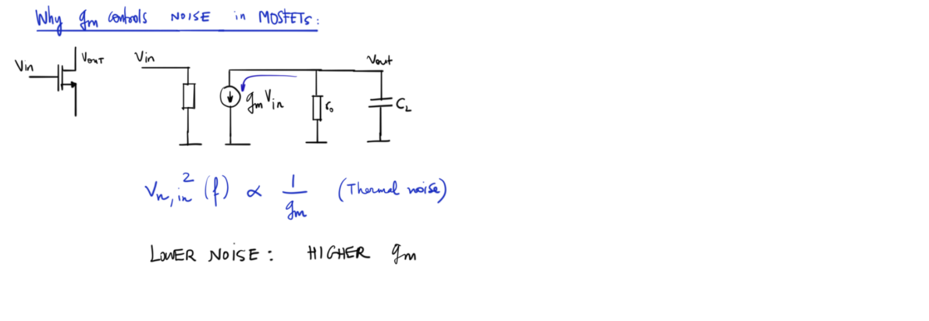
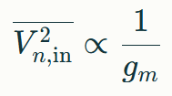
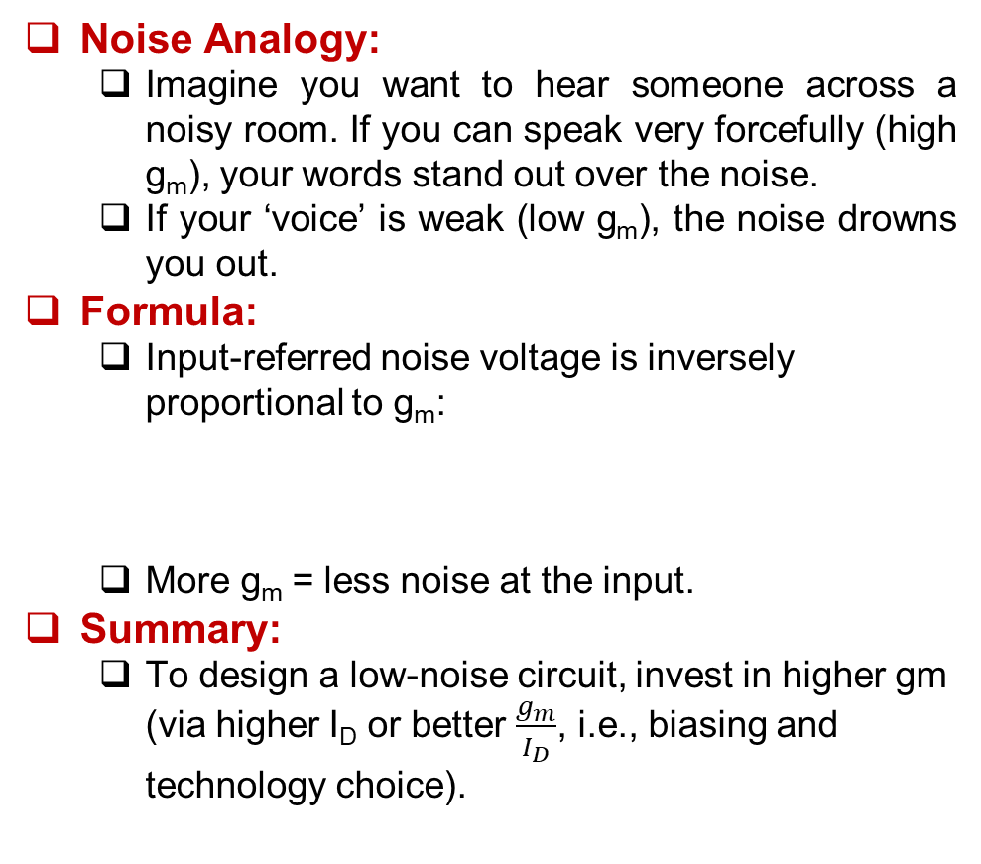
g_{m} and Noise (Clarity vs. Strength Analogy)
Noise Analogy:
  Imagine you want to hear someone across a noisy room. If you can speak very forcefully (high g_{m}), your words stand out over the noise.
  If your ‘voice’ is weak (low g_{m}), the noise drowns you out.
Formula:
  Input-referred noise voltage is inversely proportional to g_{m}:
  More g_{m} = less noise at the input.
Summary:
  To design a low-noise circuit, invest in higher gm (via higher I_{D} or better $\frac{g_{m}}{I_{D}}$, i.e., biasing and technology choice).

Slide 24
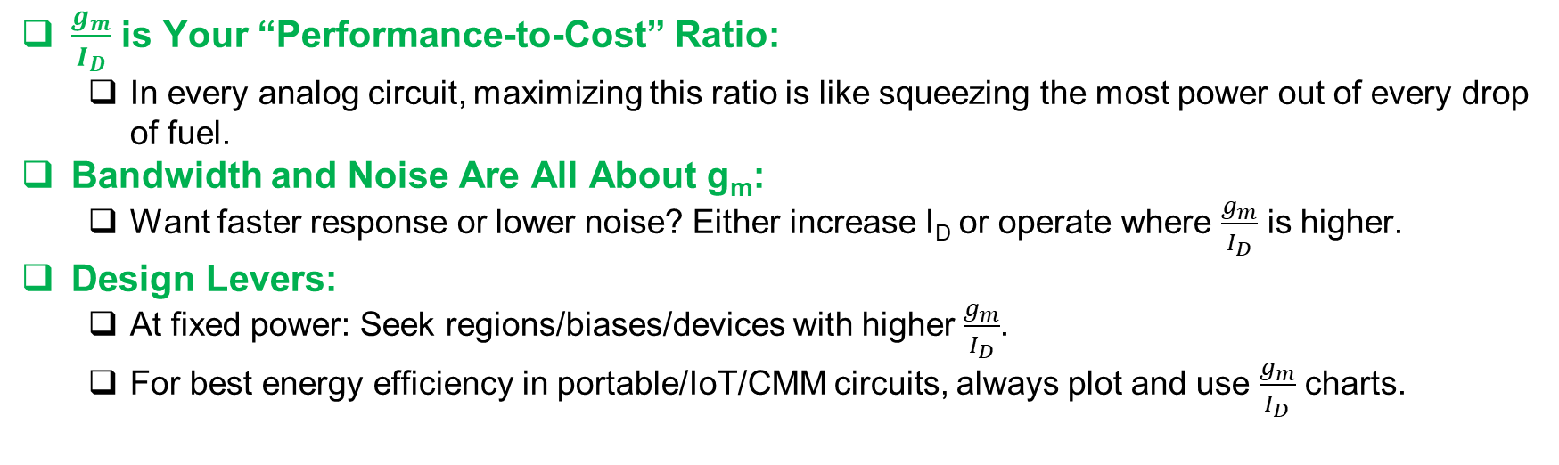
Takeaways for Design
$\frac{g_{m}}{I_{D}}$ is Your “Performance-to-Cost” Ratio:
  In every analog circuit, maximizing this ratio is like squeezing the most power out of every drop of fuel.
Bandwidth and Noise Are All About g_{m}:
  Want faster response or lower noise? Either increase I_{D} or operate where $\frac{g_{m}}{I_{D}}$ is higher.
Design Levers:
  At fixed power: Seek regions/biases/devices with higher $\frac{g_{m}}{I_{D}}$.
  For best energy efficiency in portable/IoT/CMM circuits, always plot and use $\frac{g_{m}}{I_{D}}$ charts.

Slide 25
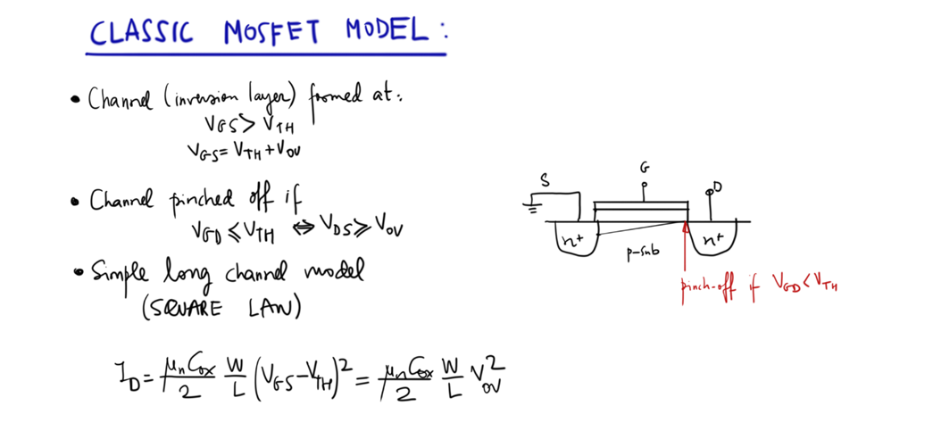
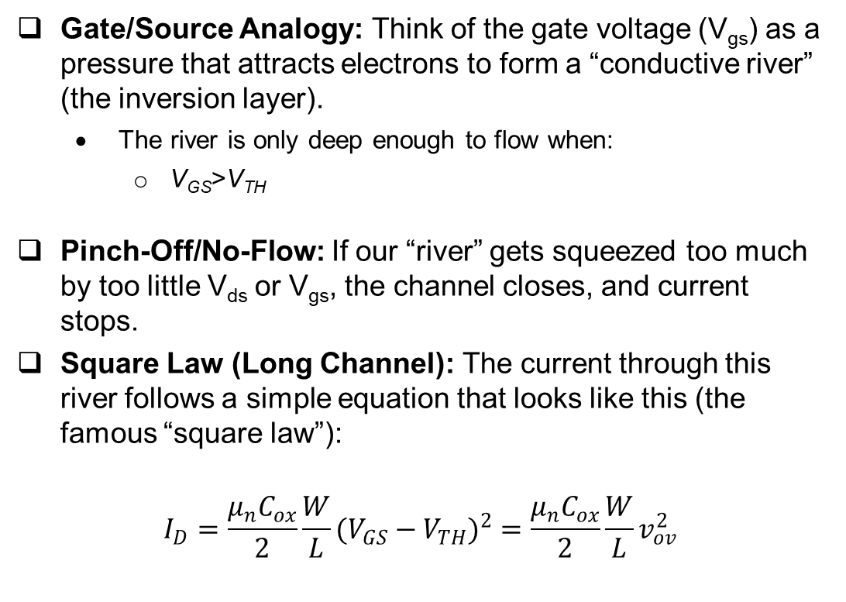
The Classic MOSFET Model — Making the Channel
Gate/Source Analogy: Think of the gate voltage (V_{gs}) as a pressure that attracts electrons to form a “conductive river” (the inversion layer).
  The river is only deep enough to flow when:
    V_{GS}>V_{TH}
Pinch-Off/No-Flow: If our “river” gets squeezed too much by too little V_{ds} or V_{gs}, the channel closes, and current stops.
Square Law (Long Channel): The current through this river follows a simple equation that looks like this (the famous “square law”):
$$I_{D}=\frac{μ_{n}C_{ox}}{2}\frac{W}{L}(V_{GS}−V_{TH})^{2}=\frac{μ_{n}C_{ox}}{2}\frac{W}{L}v_{ov}^{2}$$
Analogy: The deeper the river (higher V_{GS}-V_{TH}), the more water (current) flows, but it grows with the square of the depth.

Slide 26
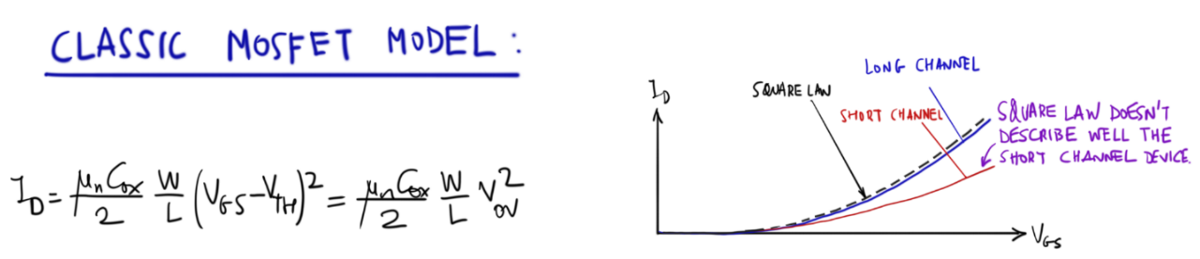
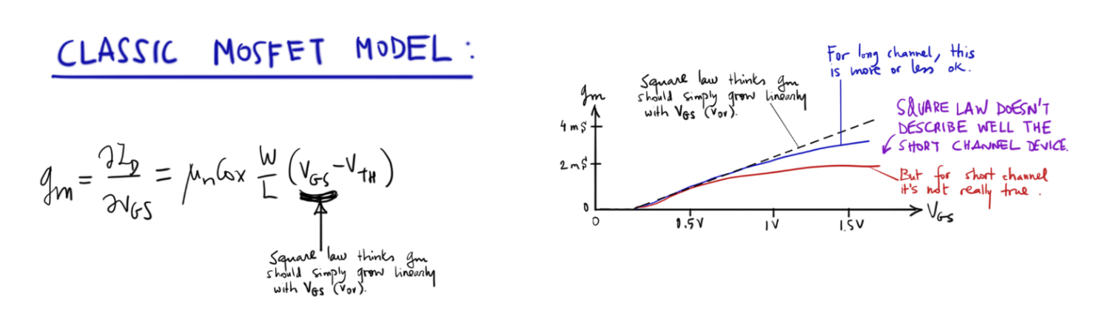
Visualizing the Model (Graphs)
(I_{D} vs V_{gs})
For long “smooth” channels, current grows as the square of gate voltage over threshold.
For short channels, the riverbed isn’t as simple—current grows faster and the classic law fails.
Takeaway: Classic models are good on long stretches of river (long-channel devices), but break down on short, rough riverbeds.
(g_{m} vs V_{gs})
The “g_{m}” is how responsive the current is to a change in V_{gs}—think of it as sensitivity of water flow to adjusting the dam gate.
Long channels: gm rises linearly with gate voltage over threshold.
Short channels: Real-world messiness breaks the classic linear rise

Slide 27
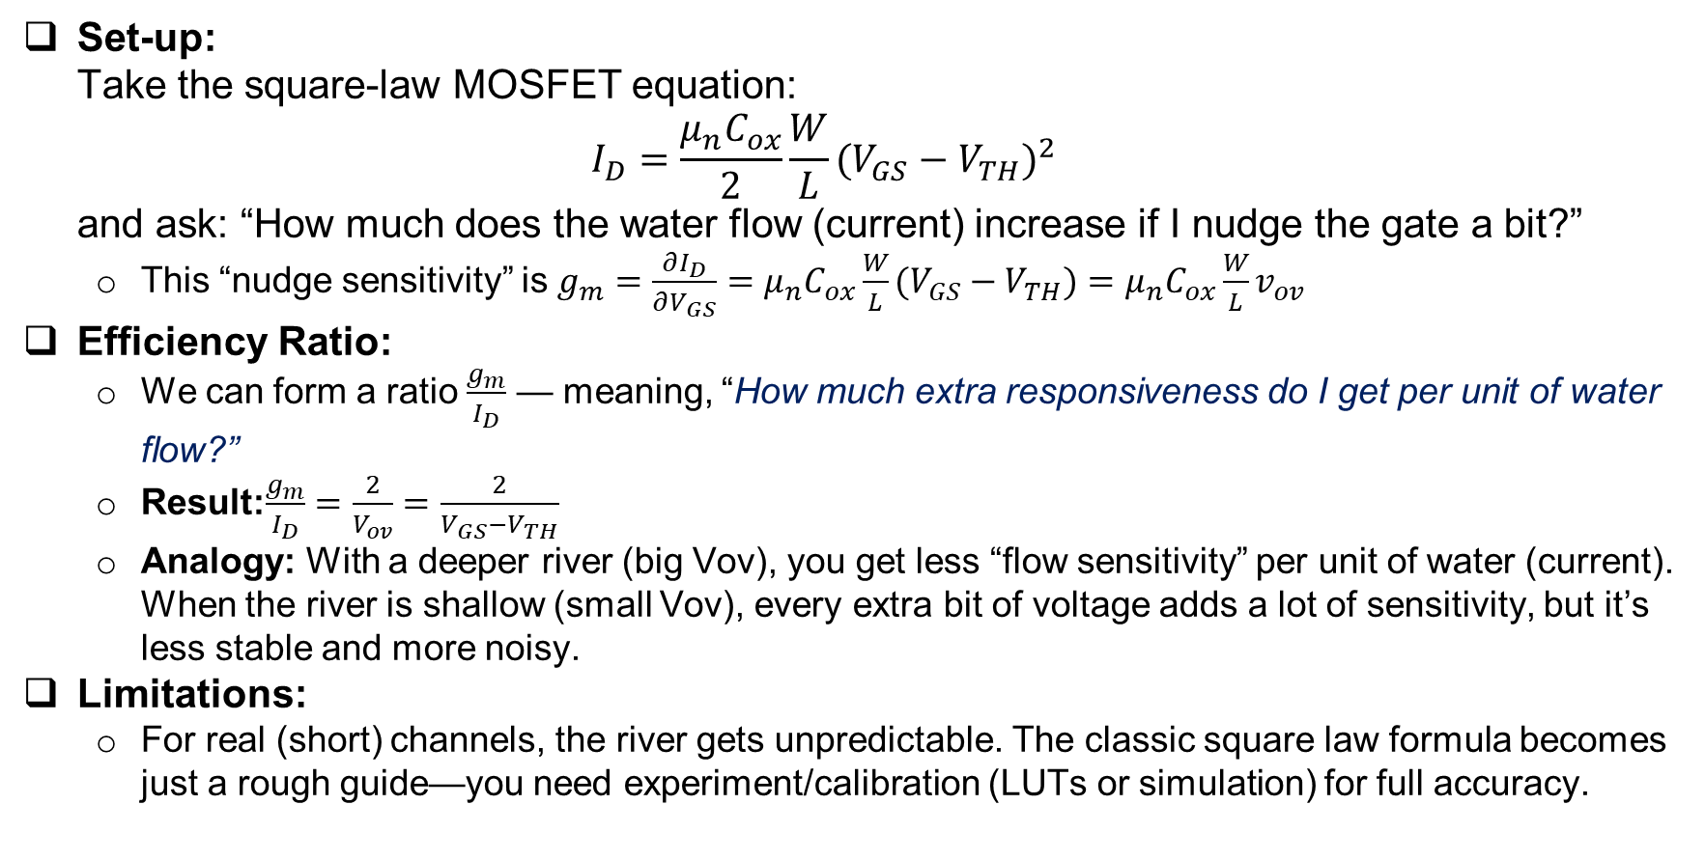
Deriving and Using $\frac{g_{m}}{I_{D}}$ (Efficiency)
Set-up:
Take the square-law MOSFET equation:
$$I_{D}=\frac{μ_{n}C_{ox}}{2}\frac{W}{L}(V_{GS}−V_{TH})^{2}$$
and ask: “How much does the water flow (current) increase if I nudge the gate a bit?”
  This “nudge sensitivity” is $g_{m}=\frac{∂I_{D}}{∂V_{GS}}=μ_{n}C_{ox}\frac{W}{L}(V_{GS}−V_{TH})=μ_{n}C_{ox}\frac{W}{L}v_{ov}$
Efficiency Ratio:
  We can form a ratio $\frac{g_{m}}{I_{D}}$ — meaning, “How much extra responsiveness do I get per unit of water flow?”
  Result:$\frac{g_{m}}{I_{D}}=\frac{2}{V_{ov}}=\frac{2}{V_{GS}−V_{TH}}$
  Analogy: With a deeper river (big Vov), you get less “flow sensitivity” per unit of water (current). When the river is shallow (small Vov), every extra bit of voltage adds a lot of sensitivity, but it’s less stable and more noisy.
Limitations:
  For real (short) channels, the river gets unpredictable. The classic square law formula becomes just a rough guide—you need experiment/calibration (LUTs or simulation) for full accuracy.

Slide 28
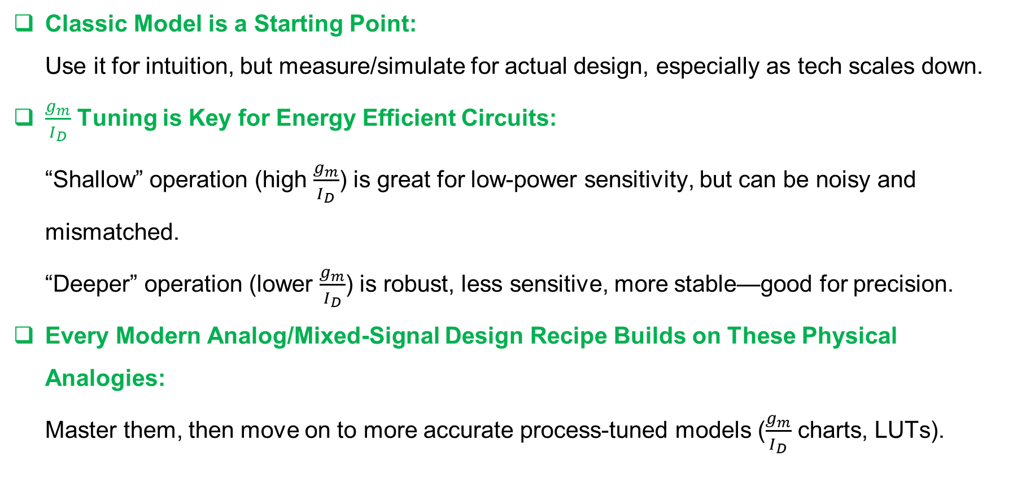
Big Picture Design Takeaways
Classic Model is a Starting Point:
Use it for intuition, but measure/simulate for actual design, especially as tech scales down.
$\frac{g_{m}}{I_{D}}$ Tuning is Key for Energy Efficient Circuits:
“Shallow” operation (high $\frac{g_{m}}{I_{D}}$) is great for low-power sensitivity, but can be noisy and mismatched.
“Deeper” operation (lower $\frac{g_{m}}{I_{D}}$) is robust, less sensitive, more stable—good for precision.
Every Modern Analog/Mixed-Signal Design Recipe Builds on These Physical Analogies:
Master them, then move on to more accurate process-tuned models ($\frac{g_{m}}{I_{D}}$ charts, LUTs).

Slide 29
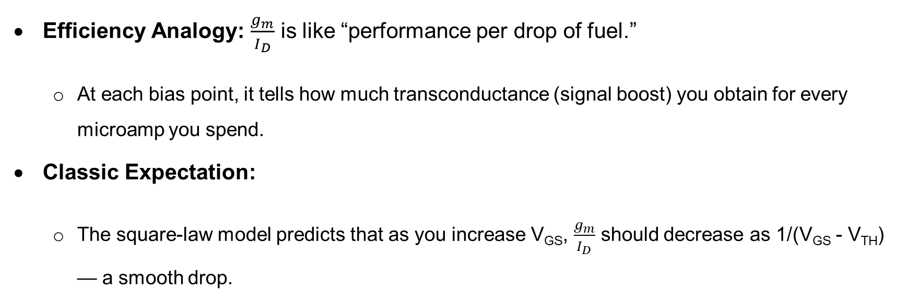
What Does $\frac{g_{m}}{I_{D}}$ Really Show Us?
Efficiency Analogy: $\frac{g_{m}}{I_{D}}$ is like “performance per drop of fuel.”
  At each bias point, it tells how much transconductance (signal boost) you obtain for every microamp you spend.
Classic Expectation:
  The square-law model predicts that as you increase V_{GS}, $\frac{g_{m}}{I_{D}}$ should decrease as 1/(V_{GS} - V_{TH}) — a smooth drop.

Slide 30
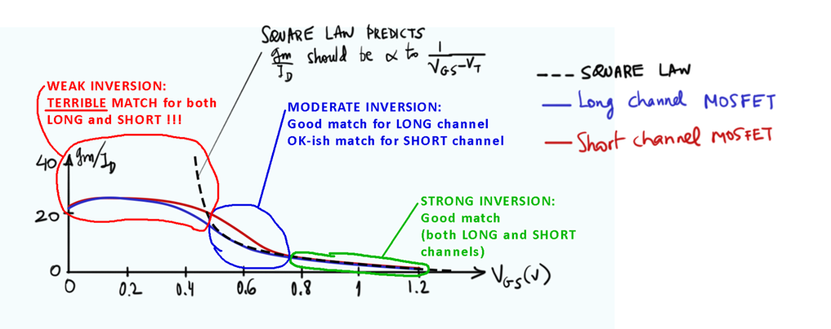
Real Devices – Long vs Short Channel
Graph Insight:
  The dashed line is the ideal (square law, long-channel).
  The blue line is a real long-channel MOSFET.
  The red line is a modern short-channel MOSFET (what we actually fabricate!).

Slide 31
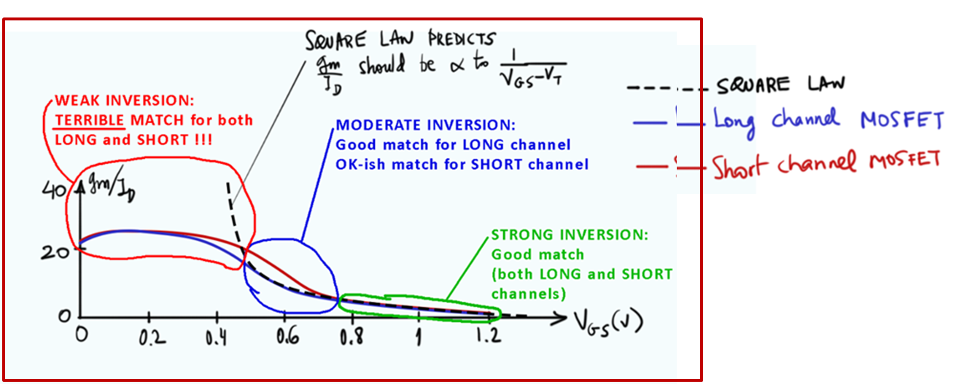
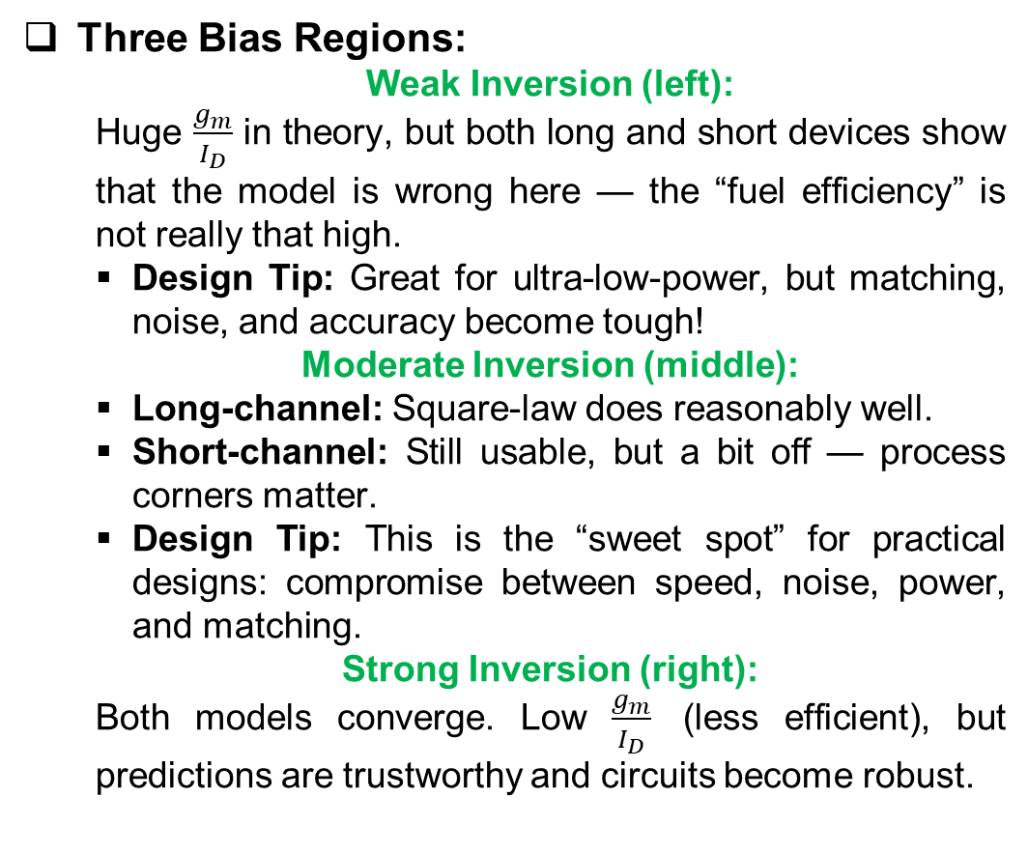
Cont..
Three Bias Regions:
  Weak Inversion (left):
  Huge $\frac{g_{m}}{I_{D}}$ in theory, but both long and short devices show that the model is wrong here — the “fuel efficiency” is not really that high.
  Design Tip: Great for ultra-low-power, but matching, noise, and accuracy become tough!
  Moderate Inversion (middle):
  Long-channel: Square-law does reasonably well.
  Short-channel: Still usable, but a bit off — process corners matter.
  Design Tip: This is the “sweet spot” for practical designs: compromise between speed, noise, power, and matching.
  Strong Inversion (right):
  Both models converge. Low $\frac{g_{m}}{I_{D}}$ (less efficient), but predictions are trustworthy and circuits become robust.

Slide 32
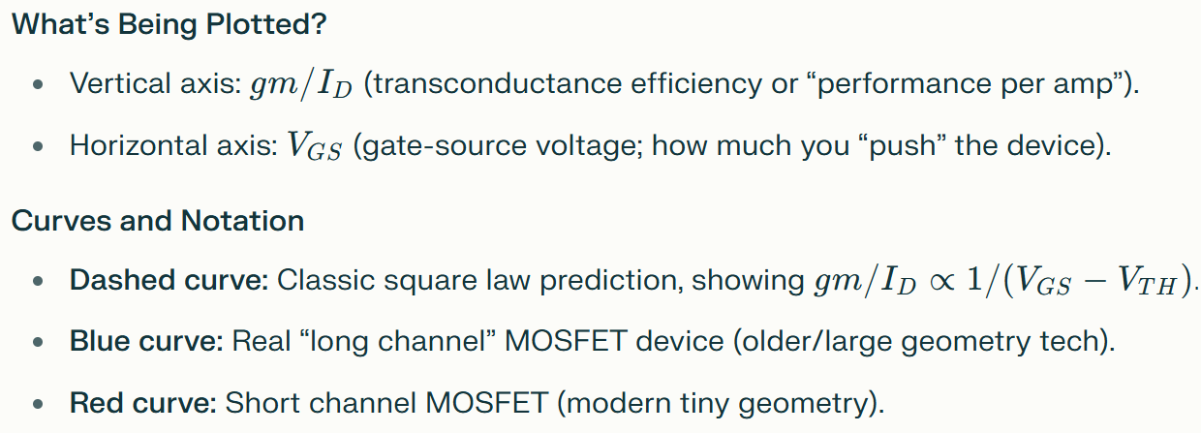
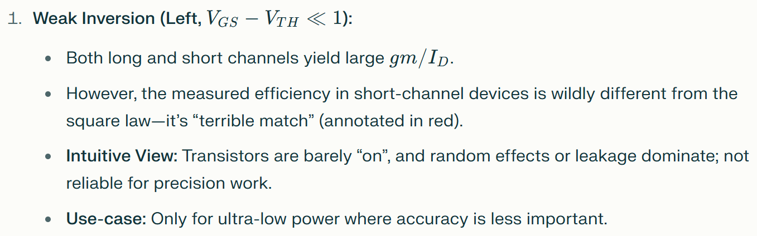
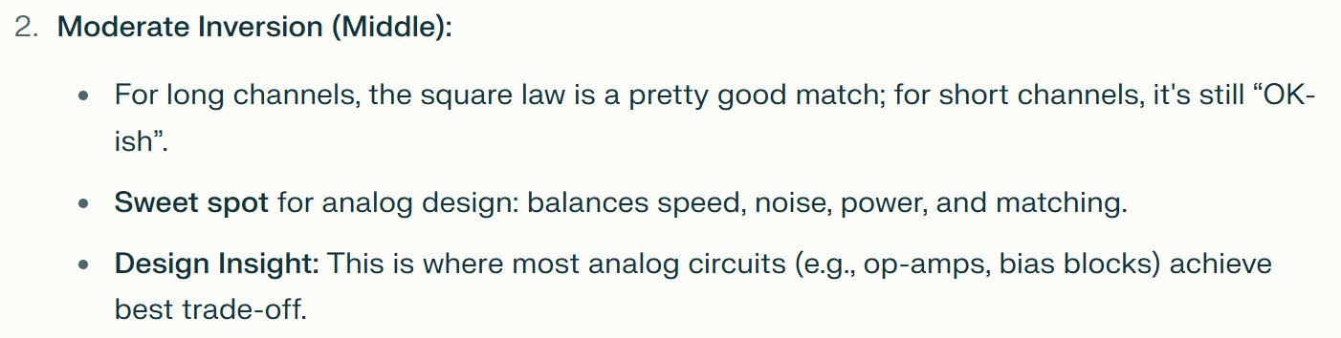
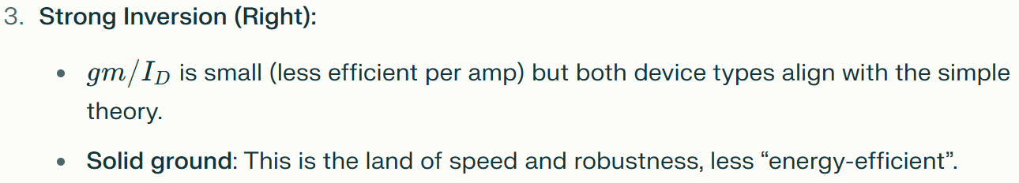
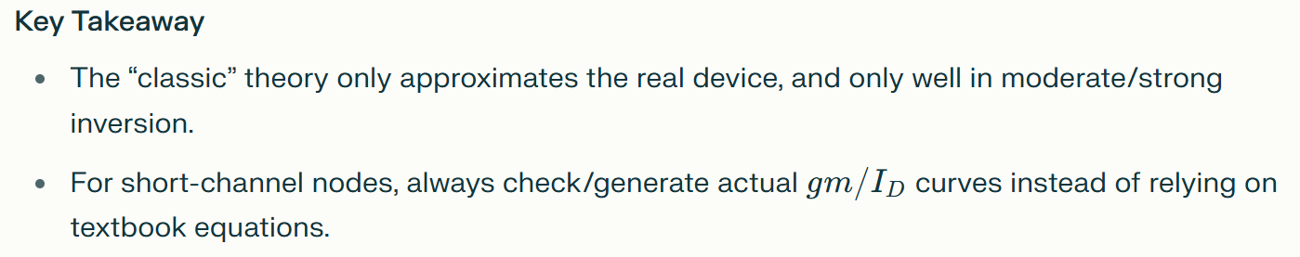

Slide 33
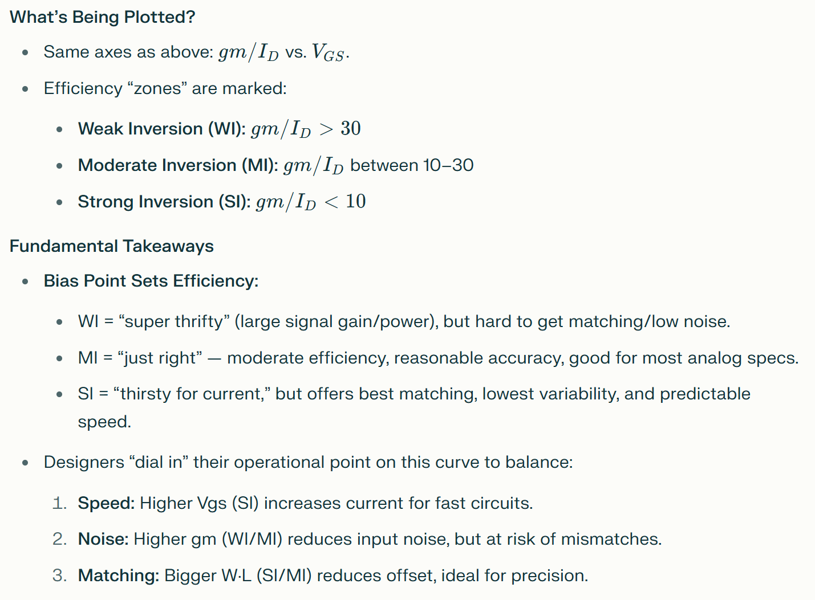
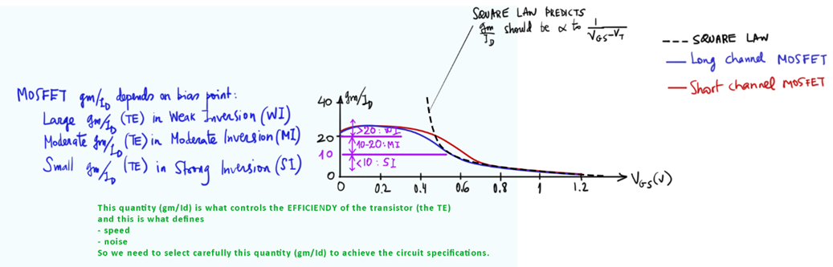

$\frac{g_{m}}{I_{D}}$ Regions, Circuit Implications, and Efficiency Zones

Slide 34

Why Your Bias Choice Matters
Speed: Moderate inversion gives you both bandwidth and low noise.
Noise: Lower input noise = higher g_{m} (but you pay in current).
Mismatch: Higher area (larger W·L) and/or moderate inversion reduces offset and drift.
Design Takeaway:
You can “dial in” a $\frac{g_{m}}{I_{D}}$ that matches your spec — but each region involves tradeoffs in current budget, speed, and variability.
Visual Summary with Numbers
Efficiency Zones on the Curve:
  40+: Weak inversion (WI), super “efficient,” but dangerous for precision.
  20-40: Moderate inversion (MI), the “engineer’s sweet spot.”
  10 and below: Strong inversion (SI), safe and reliable.
Always Remember:
  The square-law is a useful guide, not the ground truth — always cross-check with measured/simulated $\frac{g_{m}}{I_{D}}$ curves for your actual device and technology node.
  The choice of $\frac{g_{m}}{I_{D}}$ decides your circuit’s speed, noise, power, and ultimately its real-world success.

Slide 35

Cont.

Slide 36

$\frac{g_{m}}{I_{D}}$ Regions—Mapping Bias to Efficiency
A g_{m}/I_{D} versus VGS curve for MOSFETs, with three zones clearly marked:
WI (Weak Inversion): g_{m}/I_{D}≥20
MI (Moderate Inversion): 10< g_{m}/I_{D} <20
SI (Strong Inversion): g_{m}/I_{D} <10
Dashed curve: Classic long-channel theory.
Blue (long channel) and red (short channel) lines:
Actual device behavior, Interpretation & Design Insight:
Weak Inversion (WI):
Large g_{m}/I_{D}—“super mileage” per microamp.
Like “tiptoeing”—very low current, highly sensitive (good for ultra-low-power sensors or bias circuits).
Drawback: Poor prediction with short-channel models, higher noise/mismatch, risk of parameter drift.
Moderate Inversion (MI):
Sweet spot for analog: balances energy efficiency and practical robustness.
You get good speed/noise, reasonable current, and the model is still reliable (especially for long channel).
Strong Inversion (SI):
Small g_{m}/I_{D}; you’re now “flooring the gas.”
High current for low noise or speed critical blocks (buffers, high-speed opamps).
The theory matches real devices; robust but energetically expensive.
Core Message:
Where you set your bias on this gm/ID curve dictates the noise, power, and matching in every analog cell you build. For most analog/RF designs, aim for moderate inversion unless extreme low power or ultra-precision is mandated

Slide 37


The Subthreshold (Weak Inversion) Regime
(Key Concepts):
In subthreshold (WI):
$\frac{g_{m}}{I_{D}}$ saturates—it stops rising, even as VGS decreases further.
log(I_{D}) vs. V_{GS} is a straight line (like in BJTs), meaning I_{D} grows exponentially with V_{GS}.
This is why subthreshold “feels” like BJT operation.
Designer tip: In WI, $\frac{g_{m}}{I_{D}}$ is predictable (for long channel), but real world rarely matches the theory for very small (advanced) MOSFETs.

Slide 38

Cont..
1
I_{D} vs. V_{GS}:
Long channel: matches “square law” far right, straight log line in subthreshold.
Short channel: deviates significantly at low V_{GS}.
g_{m} vs. V_{GS}:
Theory: should increase linearly in SI (right), flatten in WI (left).
Short channel effect: Early deviations, less predictability.
log(I_{D}) vs. V_{GS}:
Slope is constant in WI, confirming exponential relationship.
$\frac{g_{m}}{I_{D}}$ vs V_{GS} Curve:
Again, big efficiency in WI (but not as big as ideal).
Sharp drop into strong inversion; model and device finally converge.
1
2
2
3
3
4
4
Similarity to BJT:
In subthreshold, the MOSFET operates similarly to BJTs—I_{D} depends exponentially on V_{GS}. This is harnessed in circuits like current mirrors, bandgap references, and low-power sensors

Slide 39

Summary Tabel
Region | gm/ID | Pros | Cons | Core Use
Weak Inversion | >20 | Extreme efficiency | Poor matching, more noise | Ultra-low power blocks
Moderate Inversion | 10–20 | Best tradeoff (speed, IQ) | Calibration may be needed | Precision analog, general
Strong Inversion | <10 | Robust, predictable | Poor efficiency (high IQ) | High-speed, low noise
Understand that $\frac{g_{m}}{I_{D}}$ vs. V_{GS} breakdown is not just “textbook” – it determines the achievable power, noise, and match in every analog design you do. Weak inversion is king for efficiency, strong inversion for robustness, and moderate for all-around excellence. Always cross-check your modeling zone with real process data—especially in modern, short-channel tech.

Slide 40

MOSFET in Subthreshold: Fundamental Physics
What does “subthreshold” mean?
  A MOSFET operates in subthreshold (also called weak inversion) when the gate-source voltage V_{GS} is less than the threshold voltage V_{TH}, or equivalently, V_{GS}−V_{TH} is small (but the device is not fully off).
  In this regime, channel conduction is not due to strong inversion carriers, but to diffusion — much like how a bipolar junction transistor (BJT) works.
The BJT Analogy
  The MOSFET’s gate acts like a “virtual base,” capacitively coupled to the channel through a divider made of C_{OX} (oxide capacitance) and C_{dep} (depletion capacitance).
  The effective “base-emitter” voltage for the analog BJT becomes:
  $$V_{BE}=V_{GS}\frac{C_{OX}}{C_{OX}+C_{dep}}=\frac{V_{GS}}{n}$$
    Here, n (the subthreshold slope factor) is always greater than 1; lower is better for efficiency:
      Bulk MOS: n≈1.2 to 1.5
      SOI/FinFET: n≈1.1 (thanks to very low C_{dep})
Current Equation in Subthreshold
  The drain current grows exponentially with VGS:
  $$I_{D}=I_{off}⋅e^{V_{GS}/(nU_{T})}$$
    U_{T} is the thermal voltage (≈26mV≈26mV at room temp)
  Logarithmically, log(I_{D}) vs V_{GS} is a straight line — the key signature of subthreshold.

Slide 41

Cont..

Slide 42


$\frac{g_{m}}{I_{D}}$ in Weak Inversion/Subthreshold
Theoretical Foundation
By differentiating I_{D} with respect toV_{GS}:
  $g_{m}=\frac{∂I_{D}}{∂V_{GS}}=\frac{I_{D}}{nU_{T}}$
  Thus $\frac{g_{m}}{I_{D}}=\frac{1}{nU_{T}}$
At room temperature (UT≈26mVUT≈26mV):
  For n=1.1: $\frac{g_{m}}{I_{D}}$≈35S/A
  For n=1.5: $\frac{g_{m}}{I_{D}}$≈25 S/A
Key fact: In weak inversion, $\frac{g_{m}}{I_{D}}$ is constant; it does not increase as current decreases further.
Practical Range
For all practical bulk or SOI/FinFET MOSFETs, as annotated:
  25<$\frac{g_{m}}{I_{D}}$<35S/A in subthreshold
This is a “ceiling” for performance-per-amp efficiency — you cannot get better in real silicon at room temperature
Device Plots and Comparison
The bottom plot shows that, in weak inversion,
Both long and short channel curves saturate to this flat regime (marked by BJT-like and theoretical value lines).
The curve lines up with theory in this leftmost region regardless of short/long channel (though real short-channel behavior may show deviations at ultrasmall nodes).

Slide 43


Additional Insights
Why is this Important for Analog Design?
Subthreshold Design:
  Favored in ultra-low-power (ULP), IoT, and biomedical designs, where every nanoamp counts.
  Offers the maximum efficiency (highest gm per amp), but at the cost of greater sensitivity to mismatch, parameter spread, and low speed.
Selection of n (Slope Factor):
  SOI and FinFET processes (due to reduced depletion capacitance) allow for slightly better efficiency than bulk, but the practical difference is small.
Limits of the Model:
  Even as V_{GS} is reduced, $\frac{g_{m}}{I_{D}}$ cannot exceed this theoretical range because device physics, not circuit design, sets the limit.
Parameter | Bulk MOS | SOI/FinFET
n (slope factor) | 1.2 – 1.5 | 1.1
$\frac{g_{m}}{I_{D}}$ (S/A, WI) | 25 – 32 | up to 35
Behavior in WI | Exponential, flat $\frac{g_{m}}{I_{D}}$ | Exponential, higher ceiling

Slide 44

Cont.
Graphical Takeaway
  On a semilog plot, I_{D} vs V_{GS} is a straight line in WI.
  $\frac{g_{m}}{I_{D}}$ vs V_{GS} is flat and constant for reasonable technology parameters.
  This is the best achievable “bang per buck” for transconductance in the subthreshold/weak inversion regime
In conclusion:
The subthreshold region of MOSFET operation is analogous to bipolar transistor action, characterized by exponentially rising current, a constant and process-limited transconductance efficiency, and practical constraints set by the physical parameter n. For analog designers, this provides a predictable, technology-bound foundation for ULP circuit synthesis and a rigorous limit on analog performance in WI operation.

Slide 45

Overview: Moderate Inversion in MOSFETs
Moderate inversion is the bias regime where the gate overdrive (V_{GS}−V_{TH}) is neither very small (weak inversion) nor very large (strong inversion). This is the region most practical analog designers target for balanced energy efficiency, speed, and robustness.
Key Features:
  Decently high $\frac{g_{m}}{I_{D}}$: Still good “transconductance per amp” (efficiency).
    ✓ Enables low-noise, low-power design.
  Decently high $\frac{g_{m}}{g_{ds}}$: Good intrinsic gain (signal boost), supports good analog performance.
    ✓ Useful for achieving desired gain without excessive current.
  However, no simple textbook model: Behavior is not fully captured by either subthreshold exponential law or strong inversion square law.
    ✗ Requires lookup tables, measurements, or simulation for precise design.

Slide 46




Moderate Inversion in MOSFETs deep Dive
In moderate inversion (MI), the curve transitions from the exponential climb of subthreshold (WI) toward the quadratic shape of strong inversion (SI).
Interpretation: MI produces drain currents that are not “as thrifty” as WI, but much better than SI.
Left: Weak Inversion (WI) — Saturated, high value (>20S/A), set by physics.
Middle: Moderate Inversion (MI) — Drops smoothly, but still elevated (10−20S/A).
Right: Strong Inversion (SI) — Falls to <10S/A, typical classic square law regime.
Key Insight: In MI, both long- and short-channel MOSFETs are reasonably close to textbook square law, but not exact — calibration/LUT is required.
In MI, $\frac{g_{m}}{g_{ds}}$ is well above subthreshold and often much better than SI.
BJT and subthreshold models (“horizontal lines”) do not apply here; the real device transitions between fundamental limits.
In analog circuits, higher $\frac{g_{m}}{g_{ds}}$ = higher open-loop gain (important for error amplifiers, OTAs, analog filters).

Slide 47

Practical Design Takeaways
Why use Moderate Inversion?
  Most analog building blocks (OPAMPs, OTAs, bias circuits) are optimized in moderate inversion. This gives a sweet spot for:
    Power versus noise tradeoff.
    High bandwidth (for speed).
    Adequate matching for most specs.
  Moderate inversion provides flexibility and reliability that is hard to get in either extreme regime.
How to Design in MI?
  Since there’s no simple closed-form model:
    Use $\frac{g_{m}}{I_{D}}$ lookup tables (LUTs) generated from simulation/measurement for the specific process node.
    Plug MI values directly into sizing equations (e.g., current mirrors, input pairs, gain stages).
    Continuously verify with layout-aware and corner-aware simulation.
  Remember: Modern, short-channel nodes require LUT-based design for accuracy.
Bottom Line:
  MI is the "engineer's region"—not as theoretically “clean” as WI or SI, but the most practical, tunable, and robust for most analog/RF IC needs.

Slide 48
Table of $\frac{g_{m}}{I_{D}}$ Regimes:
Region | gm/ID | Model Used | Best Application
Weak Inversion (WI) | >20 S/A | Subthreshold/BJT | Ultra-low power, sensors
Moderate (MI) | 10–20 S/A | LUT, no simple model | Precision analog, general
Strong Inversion (SI) | <10 S/A | Square law | Buffers, high-speed stages
Moderate inversion blends efficiency, noise, speed, and precision. Though it lacks a simple closed-form MOSFET model, it represents the heart of modern analog design—practically optimized, empirically guided, and fundamental for sizing in gm/ID-driven methodologies. Your figure precisely illustrates this regime’s importance and why analog designers must embrace lookup-driven, simulation-backed design in MI for state-of-the-art circuits.

Slide 49
Discussion
1. The Fundamental Challenge:
  Moderate inversion is a "transition" region between classic strong inversion and weak inversion for MOSFET operation.
  Unlike strong inversion (well-modeled by the quadratic "square law") and weak inversion (well-modeled by exponential subthreshold equations), no simple, closed-form model exists for moderate inversion.
2. Existing Models—Their Limitations:
  Square Law (Strong Inversion): Good for large overdrive; very intuitive, but often inaccurate outside SI.
  Subthreshold Exponential (Weak Inversion): Good for very low current and small overdrive; also intuitive, but not valid in most analog designs.
  Moderate Inversion: Sits between SI and WI; not accurately described by either model above.
3. About "Accurate" Models:
  Highly accurate models (such as BSIM, EKV, and foundry-specific SPICE models) DO cover moderate inversion, but:
    They sacrifice intuition (complex expressions, not directly related to gm, speed, specs, or bias current).
    They are impractical for hand analysis or “design intuition.”
    Circuit designers rarely use them analytically—they're excellent for simulation, but not for rapid insight.

Slide 50
4. The EKV Model Case:
  EKV is mathematically rigorous and spans all regions (weak, moderate, strong inversion).
  Design reality: While EKV can numerically size devices across all regions, it's complicated, not easily linked to core circuit specs (“how do I get more gm or more speed?”), and thus is unpopular for everyday analog sizing.
5. The Design “Philosophy”:
  Intuitive models like square law and exponential are meant for “rough trend prediction,” not accurate numbers.
  When you need actual numbers for circuit sizing (gm, gain, bandwidth), do NOT trust the simple models in MI—use empirically generated LUTs (lookup tables) instead.
6. LUT-Based Design is Practical and Preferred:
  Lookup tables (LUTs) are generated from measurements or detailed simulations for the specific process.
  The designer uses simple models for basic understanding, but relies on LUTs to translate circuit targets (e.g., “I need this gm/ID, what W/L should I use?”) into actual device dimensions.
  Bottom line: Use simple models for learning and initial estimation, but always size in MI with LUTs for device accuracy.
7. Summary for Practicing Analog Designers:
  Don’t get stuck seeking a neat, intuitive, analytical model for moderate inversion—you won’t find one that’s both accurate and usable for hand calculation.
  When working in MI (which is the “sweet spot” for many designs), combine intuitive models for understanding and trends, with LUTs or simulation-derived data for actual sizing.
  Accurate models are for simulation, not for design intuition.

Slide 51

The Five MOSFET Design Variables
Introduction
Designing analog CMOS circuits revolves around controlling and understanding five fundamental variables for each MOSFET:
Three voltages ($V_{GS},V_{DS},V_{SB}$)
Two sizing dimensions ($W,L$).
Mastery of these variables lets designers sculpt device behavior for noise, speed, precision, and area.
However, not all five variables offer equal leverage in modern design—some are rarely manipulable, while others are central to every performance tradeoff.
This lecture will present each variable, discuss its physical impact, practical manipulability, and offer a modern design methodology rooted in gm/ID-based sizing.

Slide 52


$V_{SB}$ (Source-to-Body Voltage)—Body Effect and Its Minimized Role
Physical Role: $V_{SB}$ sets the body effect, raising the threshold voltage $V_{TH}$ if the body sits above the source. This can hurt trans-conductance and slow down the circuit.
Practical Handling: Most circuits try to 'neutralize' $V_{SB}$, tying the body to the source to defeat the effect. Technologies with Deep NWELLs make this easy.
Exceptions: In some topologies (5T-OTA, differential pairs with floating sources), tying the body to the source isn't possible due to circuit needs.
Design Conclusion: $V_{SB}$ is not a primary tuning knob. It is minimized when possible and accepted as an unavoidable penalty where not.

Slide 53

The Effect of $V_{SB}$ (Body Effect) on Threshold Voltage
Step 1: Start with a bulk NMOS device.
  Nominal $V_{TH,0}=0.4 V$
  Body-source voltage, $V_{SB}=0.5 V$
  Process parameter: $γ=0.4 V^{1/2}$
  Bulk potential: $2φ_{F}=0.6 V$
Step 2: Compute new threshold voltage:
$$V_{TH}=V_{TH,0}+γ(\sqrt{|2φ_{F}+V_{SB}|}−\sqrt{|2φ_{F}|})$$
$$=0.4+0.4\left[\sqrt{0.6+0.5}−\sqrt{0.6}\right]$$
$$=0.4+0.4\left[\sqrt{1.1}−\sqrt{0.6}\right]$$
$$=0.4+0.4(1.049−0.775)$$
$$=0.4+0.4×0.274≈0.510 V$$
Step 3: Conclusion: Raising $V_{SB}$ by 0.5 V increases $V_{TH}$ by about 0.11 V, directly shifting or reducing the current possible for the same $V_{GS}$.

Slide 54


$V_{DS}$ (Drain-to-Source Voltage)—Early Effect, Gain, and Headroom
Classic Model: Square Law says current is independent of $V_{DS}$ (in saturation), but reality is more complex.
Modern Reality: Early effect/Channel-Length Modulation (CLM) causes output conductance ($r_{o}$), which limits gain. The Early voltage ($V_{A}$) relates to $r_{o}=V_{A}/I_{D}$; higher $V_{A}$ leads to higher gain.
How to Maximize $V_{A}$: Place the device deep in saturation (well beyond $V_{DS,sat}$), and use a longer device ($L$).
Constraints: Headroom limitations often restrict usable $V_{DS}$, especially in low-supply designs, making deep saturation difficult.
Design Reality: While potentially helpful for gain, $V_{DS}$ is usually dictated by supply, signal swing, and is seldom a key design knob.

Slide 55

Example 2: Output Resistance via Early Effect
Given:
$I_{D}=50 μA$
Device length: $L=0.36 μm$
Early voltage: $V_{A}=20 V$
Step 1: Compute output resistance:
$$r_{o}=\frac{V_{A}}{I_{D}}$$
$$=\frac{20}{50 × {10}^{−6}}=400 kΩ$$
Step 2: To improve gain, increase L (assume $V_{A}$ rises to 40 V):
$$r_{o}=\frac{40}{50 × {10}^{−6}}=800 kΩ$$
Design lesson: Increasing L increases $V_{A}$ and thus output resistance, but also increases area and lowers $f_{T}$.

Slide 56


$V_{GS}$ (Gate-to-Source Voltage)—The 'Control Knob' (but really, $I_{D}$)
Core Impact: $V_{GS}$ directly governs the channel, controlling transconductance, bias point, speed, and noise. It is the voltage to which people traditionally attribute most of the transistor's "control."
How Design Actually Proceeds: Rather than setting a specific $V_{GS}$, designers set reference currents ($I_{D}$) through current sources/mirrors. $V_{GS}$ is then implicitly determined by the chosen $I_{D}$, technology, and previous sizing.
Key Insight: The truly actionable lever is bias current ($I_{D}$), not direct $V_{GS}$. Modern flows thus always phrase spec trade-offs in terms of current and gm/ID, not gate voltage by itself.

Slide 57

Setting ID (via gm/ID) for Required Noise/Speed
Spec: Design an input device with
  Required gm: $1 mS$
  Technology: In moderate inversion, $g_{m}/I_{D}=15 S/A$
Step 1: Compute $I_{D}$
$$I_{D}=\frac{g_{m}}{gm/ID}=\frac{1 × {10}^{−3}}{15}=66.7 μA$$
Step 2: Result: For that noise and speed, bias the device at about 67 µA in moderate inversion

Slide 58

L (Length)—Speed, Gain, Matching, and Noise
Shorter L (minimum):
  Reduced area, minimized input gate capacitance (faster charging/discharging).
  Maximized speed (higher f_{t}).
Longer L:
  Greater Early voltage ($V_{A}$)—increases output resistance, raises gain.
  Better device matching (random mismatch reduces as area enlarges).
  Reduces flicker noise.
Design Philosophy: Choose L primarily based on the need for speed (short L) or precision (long L). For high-speed blocks, minimize L; for references, mirrors, or precise input pairs, increase L.

Slide 59


Calculating W from $\frac{g_{m}}{I_{D}}$ Table (LUT approach)
Given:
$I_{D}=67 μA$, $L=0.36 μm$, $gm/ID=15 S/A$ (moderate inversion)
gm/ID table says, for $L=0.36$, $I_{D}/(W/μm)=10 μA/μm$ at this bias
Step 1: Compute required W:
$$W=\frac{I_{D}}{I_{D}/(W/μm)}=\frac{67 μA}{10 μA/μm}=6.7 μm$$
Step 2: Chosen W is 6.7 µm. If you change ID, inversion level, or L, revisit your LUT to re-size W.

Slide 60

W (Width)—The True Sizing Variable (But the Most Interdependent)
W in Old Flows: In classic strong inversion, one could choose $V_{ov}$ ($V_{GS}−V_{TH}$) and $I_{D}$ and calculate W using square-law equations.
Modern Constraint: The square law does NOT hold for short-channel or even modern moderate and weak inversion operation:
  In MI/WI, or in short-channel devices, W must be “chased” after setting $I_{D}$, L, and desired inversion level ($\frac{g_{m}}{I_{D}}$).
  There is no direct link between $V_{ov}$ and circuit specs.
How Sizing Works Now: Use lookup tables (LUTs), which relate $\frac{g_{m}}{I_{D}}$, inversion level, and process parameters to W for a given choice of L and $I_{D}$.

Slide 61

Classic Sizing Flow (Square Law, for Intuition)
Suppose: You want $I_{D}=100 μA$, choose $V_{ov}=0.2 V$, $μ_{n}C_{ox}=200 μA/V^{2}$, $L=0.18 μm$.
$$I_{D}=\frac{1}{2}μ_{n}C_{ox}\frac{W}{L}V_{ov}^{2}$$
$$100 μA=0.5×200 μA/V^{2}×\frac{W}{0.18}×(0.2)^{2}$$
$$100=100×\frac{W}{0.18}×0.04=4×\frac{W}{0.18}$$
$$\frac{W}{0.18}=25 ⟹ W=4.5 μm$$
Result: The “classic” answer for W is 4.5 µm — but if you check a $\frac{g_{m}}{I_{D}}$ table or simulation, in modern processes this will underestimate W, especially in short channel or moderate/weak inversion.

Slide 62

Design Variables and Their Power
Variable | Physical Effect | Modern Role
$$V_{SB}$$ | Adjusts threshold | Minimize/accept
$$V_{DS}$$ | Sets r_{o}/gain | Marginal lever, dictated by circuit topology/headroom
$V_{GS}$/$I_{D}$ | Controls bias/g_{m}/speed | The main designer lever, always work in I_{D}
L | Noise/gain/speed | Trade for matching/gain/noise vs. area/speed
W | g_{m}, current, sizing | Iterate with LUTs for specs

Slide 63

Modern Sizing Methodology
Start with specs: Define speed, gain, noise, area, and current requirements.
Biasing: Choose target I_{D} (current), which underpins gm, noise, and speed.
Pick L: Based on speed vs. gain/matching tradeoff.
gm/ID Approach: Choose desired inversion level for each transistor (sets efficiency and performance tradeoffs).
Consult LUTs: Use process-specific lookup tables to map I_{D}/L/$\frac{g_{m}}{I_{D}}$ choices to final W.
Verify via Simulation: Confirm target specs in full-circuit simulation (corner/Monte Carlo as needed).
Iterate as needed: Change L or $\frac{g_{m}}{I_{D}}$, "chase" W as specs are refined.

Slide 64


Sizing Flow Comparison
Method | Steps | Accurate Today? | Usage
Square-law | Choose Vov, ID, compute W | No (except long channel/SI) | Intuition
$\frac{g_{m}}{I_{D}}$, LUT | Choose ID, L, $\frac{g_{m}}{I_{D}}$, look up W | Yes (modern flows) | Real device sizing
Intuitive, model-based thinking is critical for initial design direction, but should not be relied on for actual sizing.
Modern CMOS design, especially in advanced nodes and all but the simplest analog blocks, depends on data-driven LUTs and numerical sizing, not closed-form models.
The right methodology combines an intuitive "feel" (via simplified models) with robust, data-backed device sizing (via $\frac{g_{m}}{I_{D}}$ tables and simulation).

Slide 65
Transistor-Level Design Steps—How Beginners Should Approach Netlist Construction
Steps for transistor-level design:
What the netlist should specify:
  Each line instantiates a transistor with channel length (L) and width (W), but not mobility (μ), oxide capacitance (Cox), threshold voltage (VT), etc.
  Students realize they directly control sizing but not physical properties.
Begin with Sizing Selection:
  Use gm/ID-based design tables or charts to select W and L intelligently, connecting bias point, small-signal model, and performance.
  Avoid random guessing—ground choices in analytical pre-work.
Iterative Specification:
  Fill in W and L for each transistor in netlist based on intended role in topology and targeted small-signal behavior.
  Validate choices analytically before simulation

Slide 66
Key Intuitive Takeaways
Hand calculation phase is where insight, creativity, and optimization thrive; simulation is for verifying and fine-tuning, not for broad exploration.
gm/ID methodology allows designers to make confident sizing choices before simulation—minimizing wasteful blind tweaking and maximizing the value of circuit intuition.
A strong design flow emphasizes rapid, deep exploration in the analytical phase, ensuring simulation is just the confirmation of informed decisions, not an endless search for performance.
This approach fully aligns with modern, efficient analog design practice, ensuring that designers and students develop true intuition and control over their circuits

Slide 67

$\frac{g_{m}}{I_{D}}$-Based Device Sizing Using Reference Plots and Cross-Multiplication
Part 1: Foundation and Philosophy
1.1 The Evolution of Analog Design Methodology
Historically, analog designers relied on closed-form equations (like the square law) to size transistors. This worked reasonably well in older, longer-channel technologies where simple models matched reality. However, modern nanoscale CMOS presents challenges:
  Short-channel effects dominate
  Velocity saturation occurs at lower electric fields
  Moderate inversion (MI) is commonly used but lacks simple models
  Process variations are significant
The $\frac{g_{m}}{I_{D}}$ methodology emerged as a solution—a practical, measurement-based approach that:
  Works across all inversion regions (WI, MI, SI)
  Captures real device physics without complex equations
  Provides intuitive design decisions
  Scales across technology nodes

Slide 68

Cont..
1.2 Why $g_{m}/I_{D}$ Is the Right Design Variable
The transconductance efficiency, defined as:
$$\frac{g_{m}}{I_{D}}=\frac{\text{signal} \text{amplification} \text{capability}}{\text{power} \text{consumed}}$$
is fundamentally important because it directly relates to circuit performance:
For Speed (Bandwidth):
$$\text{GBW}=\frac{g_{m}}{2πC_{L}}=\frac{(g_{m}/I_{D})⋅I_{D}}{2πC_{L}}$$
For Noise:
$$\overline{V_{n,in}^{2}}∝\frac{1}{g_{m}}=\frac{1}{(g_{m}/I_{D})⋅I_{D}}$$
For Gain:
$$A_{v}=g_{m}⋅r_{o}=(g_{m}/I_{D})⋅I_{D}⋅r_{o}$$
Notice that $g_{m}/I_{D}$ appears in every performance metric, making it the natural variable to work with.

Slide 69

Cont..
Part 2: The Universal Scaling Law—I_{D} ∝ W
2.1 Physical Derivation
Consider the drain current equation in any operating region. At a fundamental level, current density (current per unit width) is determined by:
$$J_{D}=\frac{I_{D}}{W}=f(V_{GS},V_{DS},V_{SB},L,T,\text{process} \text{parameters})$$
The key insight: for fixed biasing (VGS, VDS, VSB), temperature, and length, the current density is constant.
Therefore:
$$I_{D}=J_{D}⋅W=\text{constant}×W$$

Slide 70

Cont..
2.2 Why This Holds Universally
In Weak Inversion:
$$I_{D}=I_{0}\left(\frac{W}{L}\right)e^{V_{GS}/(nU_{T})}\left(1−e^{−V_{DS}/U_{T}}\right)$$
Current is explicitly proportional to W.
In Strong Inversion (Square Law):
$$I_{D}=\frac{1}{2}μ_{n}C_{ox}\frac{W}{L}(V_{GS}−V_{TH})^{2}$$
Again, explicitly proportional to W.
In Moderate Inversion:
Even though there's no simple closed-form equation, the fundamental physics still holds—current flows through the width of the channel.
Physical Analogy:
Think of the transistor channel as a highway:
Width (W): Number of lanes
Current (ID): Total traffic flow
Current density (I_{D}/W): Traffic per lane
Doubling the lanes doubles the traffic capacity, regardless of road conditions (bias, temperature, etc.).

Slide 71
Cont..
2.3 Experimental Verification
This can be verified experimentally:
Fabricate devices with W₁, W₂ = 2W₁, W₃ = 3W₁ (same L)
Bias all at same V_{GS}, V_{DS}, V_{SB}
Measure: ID₂ = 2×ID₁, ID₃ = 3×ID₁ (within matching limits)

Slide 72
Cont..
Part 3: Building Reference Plots—The Foundation
3.1 What Is a Reference Device?
A reference device is a carefully chosen transistor with:
Dimensional Specifications:
  Width: W_{ref} (typically 1 μm, 2 μm, or 10 μm)
  Length: L_{ref} (typically minimum L, 2×L_min, or longer)
Why These Choices Matter:
  W_{ref}: Small enough for compact simulation, large enough for good matching
  L_{ref}: Chosen based on target application:
    Minimum L: For high-speed circuits
    2-3× minimum L: For balanced speed/gain
    Longer L: For precision analog (ADCs, references, bias circuits)

Slide 73

Cont..
3.2 Generating Reference Data—Step by Step
Step 1: Set Up SPICE Simulation
Create a testbench with:
* Reference device
M1 drain gate source body nmos W=2u L=0.2u
* DC voltage sources
Vgs gate source DC=sweep
Vds drain source DC=1.2V
Vss source 0 DC=0
Vbb body 0 DC=0
* Measurement statements
.dc Vgs 0 1.5 0.01
.print dc I(Vds) @M1[gm] @M1[gds]
Step 2: Sweep and Extract
Sweep V_{GS} from 0 to V_{DD} (e.g., 0 to 1.5V in 10mV steps) and extract:
  I_{D}: Drain current
  g_{m} = ∂I_{D}/∂V_{GS}: Transconductance
  g_{ds} = ∂I_{D}/∂V_{DS}: Output conductance
  C_{gg}, C_{gs}, C_{gd}: Capacitances
Step 3: Calculate Derived Quantities
For each VGS point, compute:
$$\frac{g_{m}}{I_{D}}=\frac{g_{m}}{I_{D}}$$
$$g_{m}r_{o}=\frac{g_{m}}{g_{ds}}$$
$$f_{T}=\frac{g_{m}}{2πC_{gg}}$$
Step 4: Generate Plots
Create these essential plots:
  I_{D} vs V_{GS}: Shows current-voltage characteristic
  g_{m}/I_{D} vs V_{GS}: Shows efficiency vs bias
  g_{m}/I_{D} vs I_{D}: Direct lookup for sizing
  f_{t} vs g_{m}/I_{D}: Speed vs efficiency tradeoff
  g_{m}·r_{o} vs g_{m}/I_{D}: Intrinsic gain vs efficiency

Slide 74


Cont..
3.3 Understanding the Reference Plots
Looking at your figures, we see three distinct curves:
Dashed Line (Square Law):
  Theoretical prediction
  Assumes long channel, no short-channel effects
  $g_{m}/I_{D}=\frac{2}{V_{GS}−V_{TH}}$ in strong inversion
Blue Curve (Long Channel MOSFET):
  Actual device with larger L (e.g., L = 1 μm)
  Closer to square law but still deviates
  Shows velocity saturation effects
Red Curve (Short Channel MOSFET):
  Modern device (e.g., L = 0.18 μm)
  Significant deviations from square law
  This is what you'll actually design with!

Slide 75

Cont..
Part 4: The Cross-Multiplication Method—Complete Derivation
4.1 Mathematical Foundation
Starting Point:
We have a reference device characterized by (W_{ref}, L_{ref}) with known behavior: I_{Dref}(V_{GS}) and corresponding $\frac{g_{m}}{I_{D}}$ values.
Design Problem:
We need a new device that delivers I_{Dnew} at the same $\frac{g_{m}}{I_{D}}$ as the reference.
Key Assumption:
Since I_{D} ∝ W (proven in Part 2), we can write:
  For reference device:
  $$I_{D,ref}=k⋅W_{ref}$$
  For new device:
  $$I_{D,new}=k⋅W_{new}$$
  where k is the current density ($\frac{I_{D}}{W}$), which depends on V_{GS}, V_{DS}, L, etc.
Critical Insight:
If we want the same $\frac{g_{m}}{I_{D}}$, we must operate at the same V_{GS}, which means same k (current density).
  Therefore:
  $$\frac{I_{D,ref}}{W_{ref}}=\frac{I_{D,new}}{W_{new}}=k$$
  Cross-multiplying:
  $$I_{D,ref}⋅W_{new}=I_{D,new}⋅W_{ref}$$
  Solving for W_{new}:
  $$W_{new}=W_{ref}×\frac{I_{D,new}}{I_{D,ref}}$$

Slide 76

Cont..
4.2 What Remains Constant?
When using cross-multiplication, the following parameters do not change:
Geometric:
  L_{new} = L_{ref}: Length stays the same
Electrical:
  V_{GS,new} = V_{GS,ref}: Gate-source voltage stays the same
  V_{DS,new} ≈ V_{DS,ref}: Should maintain similar drain voltage (both in saturation)
  V_{SB,new} = V_{SB,ref}: Body-source voltage stays the same
Performance Metrics:
  ($\frac{g_{m}}{I_{D}}$)_{new} = ($\frac{g_{m}}{I_{D}}$)_{ref}: Efficiency stays the same
  Inversion level: WI, MI, or SI stays the same
  Current density ($\frac{I_{D}}{W}$): Stays constant

Slide 77

Cont..
4.3 What Scales Proportionally?
Linearly with W:
  ID: Scales by factor (W_{new}/W_{ref})
  gm: Scales by same factor since gm = ($\frac{g_{m}}{I_{D}}$) × ID
  Capacitances: C_{gg}, C_{gs}, C_{gd} all scale with W
  Matching (absolute): σ(ΔV) ∝ 1/√(WL), so matching improves with larger W
Unchanged:
  Threshold voltage: V_{TH}
  Transconductance efficiency: $\frac{g_{m}}{I_{D}}$
  Transit frequency: f_{t} = g_{m}/(2πC_{gg}) stays constant (both numerator and denominator scale together)
  Intrinsic gain: g_{m}·r_{o} (if r_{o} doesn't change with W, which is approximately true)

Slide 78


Cont..
Part 5: Detailed Worked Example from the Figures
5.1 Analyzing Figure
Given Reference Device Specifications:
From the handwritten notes:
Aspect ratio: $\frac{W_{ref}}{L_{ref}}=\frac{2 μm}{0.2 μm}=10$
Reference dimensions: $W_{ref}$ = 2 μm, $L_{ref}$ = 0.2 μm
Reading from the Plots:
Looking at the $\frac{g_{m}}{I_{D}}$ vs VGS curve (middle plot):
Target operating point: $\frac{g_{m}}{I_{D}}$ = 15 S/A (moderate inversion)
From the red curve (short channel): at $\frac{g_{m}}{I_{D}}$ = 15, we find:
  V_{GS} ≈ 0.6 V
  I_{Dref} ≈ 0.4 μA
Extracting Additional Information:
From ID vs $\frac{g_{m}}{I_{D}}$ plot (bottom):
Confirms: at $\frac{g_{m}}{I_{D}}$ = 15, ID = 0.4 μA for our reference device
Computing Transconductance:
$$g_{m,ref}=\frac{g_{m}}{I_{D}}×I_{D}=15×0.4 μA=6 μS$$

Slide 79


Cont..
5.2 The Design Problem
New Design Specification:
The problem states we want:
  I_{Dnew} = 0.2 mA = 200 μA (much larger current!)
  Same $\frac{g_{m}}{I_{D}}$ = 15 S/A (maintain efficiency)
  Same L = 0.2 μm (use same technology/speed)
Step 1: Identify Known Values
From reference:
  W_{ref} = 2 μm
  I_{D_ref} = 0.4 μA
  $\frac{g_{m}}{I_{D}}$ = 15
From specification:
  I_{D_new} = 200 μA
  $\frac{g_{m}}{I_{D}}$ = 15 (same efficiency point)
Step 2: Apply Cross-Multiplication Formula
$$W_{new}=W_{ref}×\frac{I_{D,new}}{I_{D,ref}}$$
Step 3: Calculate Numerically
$$W_{new}=2 μm×\frac{200 μA}{0.4 μA}$$
$$W_{new}=2 μm×500$$
$$W_{new}=1000 μm=1 mm$$

Slide 80


Cont..
Step 4: Verify Other Parameters
Length remains the same:
$$L_{new}=L_{ref}=0.2 μm$$
Gate voltage remains the same:
$$V_{GS,new}=V_{GS,ref}=0.6 V$$
Transconductance scales linearly:
$$g_{m,new}=\frac{g_{m}}{I_{D}}×I_{D,new}=15×200 μA=3 mS$$
Verification ratio:
$$\frac{g_{m,new}}{g_{m,ref}}=\frac{3000 μS}{6 μS}=500=\frac{W_{new}}{W_{ref}} ✓$$
Step 5: Physical Implementation Considerations
A 1 mm wide device is quite large! Practical implementation strategies:
Option 1: Multi-finger Layout
  Break into N fingers: W_finger = W_new/N
  Example: 20 fingers × 50 μm each
  Benefits: Better matching, lower gate resistance
Option 2: Multiple Devices in Parallel
  Use M devices: W_each = W_new/M
  Example: 10 devices × 100 μm each
  Benefits: Modularity, easier layout
Checking Layout Sanity:
Gate resistance:
$$R_{G}≈\frac{1}{3}R_{sheet}\frac{W^{2}}{L}\frac{1}{N_{fingers}}$$
For 1 mm device as single finger:
$$R_{G}≈\frac{1}{3}×5 Ω/sq×\frac{(1000 μm)^{2}}{0.2 μm}=8.3 kΩ$$
With 20 fingers:
$$R_{G}≈\frac{8.3 kΩ}{20}=415 Ω \text{(}\text{much} \text{better}\text{!)}$$

Slide 81
Cont..
Complete Design Summary Table
Parameter | Reference Device | New Device | Scaling Factor
Width (W) | 2 μm | 1000 μm | 500×
Length (L) | 0.2 μm | 0.2 μm | 1×
Drain Current (ID) | 0.4 μA | 200 μA | 500×
Gate Voltage (VGS) | 0.6 V | 0.6 V | 1×
gm/ID | 15 S/A | 15 S/A | 1×
Transconductance (gm) | 6 μS | 3 mS | 500×
Inversion Region | Moderate | Moderate | —

Slide 82

Cont..
Part 6: Complete Design Flow for Students
6.1 Starting from Circuit Specifications
Example: Design an input differential pair for an op-amp
Given Circuit Requirements:
  Input-referred noise: < 100 nV/√Hz at 1 kHz
  Bandwidth: GBW = 10 MHz
  Load capacitance: C_{L} = 5 pF
  Power budget: I_{D,total} < 100 μA per side
  Technology: 180 nm CMOS
Step 1: Determine Required Transconductance
From bandwidth requirement:
$$\text{GBW}=\frac{g_{m}}{2πC_{L}}$$
Solving for $g_{m}$:
$$g_{m}=2π×\text{GBW}×C_{L}$$
$$g_{m}=2π×10×{10}^{6}×5×{10}^{−12}$$
$$g_{m}=314 μS≈300 μS$$

Slide 83


Cont..
Step 2: Check Noise Requirement
Input-referred noise (thermal only):
$$\overline{V_{n,in}^{2}}=\frac{4kTγ}{g_{m}}$$
For $γ≈2/3$ (long channel) and $T=300K$:
$$V_{n,rms}=\sqrt{\frac{4×1.38×{10}^{−23}×300×0.67}{300×{10}^{−6}}}×\sqrt{Δf}$$
$$V_{n,rms}/\sqrt{Hz}≈5 nV/\sqrt{Hz}$$
This is well below 100 nV/√Hz requirement, so noise is satisfied.
Step 3: Choose $\frac{g_{m}}{I_{D}}$ (Operating Point)
Considerations:
  Need moderate power (not ultra-low)
  Want good matching
  Moderate inversion is good balance
Choose: $\frac{g_{m}}{I_{D}}$ = 15 S/A
Step 4: Calculate Required Current
$$I_{D}=\frac{g_{m}}{g_{m}/I_{D}}=\frac{300 μS}{15}=20 μA$$
This is well within the 100 μA budget. ✓
Step 5: Consult Reference Plots
From your 180nm reference plots (assume you generated them):
  At $\frac{g_{m}}{I_{D}}$ = 15, for reference device ($W_{ref}$ = 2 μm, L_{ref} = 0.36 μm):
    $I_{D,ref}$ = 0.8 μA
    V_{GS,ref} = 0.55 V
Step 6: Apply Cross-Multiplication
$$W_{new}=W_{ref}×\frac{I_{D,new}}{I_{D,ref}}$$
$$W_{new}=2 μm×\frac{20 μA}{0.8 μA}$$
$$W_{new}=2×25=50 μm$$

Slide 84

Cont..
Step 7: Final Device Dimensions
$$\frac{W}{L}=\frac{50 μm}{0.36 μm}$$
Step 8: Layout Implementation
Use 5 fingers of 10 μm each:
  W_{total} = 5 × 10 μm = 50 μm
  L = 0.36 μm
  Benefits: Lower R_{G}, better matching
Step 9: Verification Simulations
Run corner simulations:
  TT corner: Verify I_{D} = 20 μA at V_{GS} = 0.55 V
  FF corner: Check I_{D} doesn't exceed budget
  SS corner: Verify g_{m} still meets spec
  Monte Carlo: Check σ(V_{TH}) and matching

Slide 85


Cont..
6.2 Decision Tree for Choosing gm/ID
Start: What is your primary constraint?
Path 1: Power is critical (battery-operated, IoT)
Choose high $\frac{g_{m}}{I_{D}}$: 20-25 S/A
Region: Weak to moderate inversion
Trade-off: Lower speed, higher noise
Application: Bias circuits, references
Path 2: Speed is critical (high-frequency amplifiers)
Choose low $\frac{g_{m}}{I_{D}}$: 5-10 S/A
Region: Strong inversion
Trade-off: Higher power, lower efficiency
Application: Wideband amplifiers, buffers
Path 3: Balanced performance (general purpose)
Choose medium $\frac{g_{m}}{I_{D}}$: 12-18 S/A
Region: Moderate inversion
Trade-off: Good compromise
Application: Op-amps, comparators, most analog blocks
Path 4: Noise is critical (sensor front-ends)
Choose medium-high $\frac{g_{m}}{I_{D}}$: 15-20 S/A
Maximize gm for given power
Also increase W for better matching
Application: Instrumentation amplifiers, LNAs

Slide 86

Cont..
Part 7: Advanced Considerations
7.1 When Cross-Multiplication Breaks Down
Limitation 1: Very Large Width Devices
For W > 200 μm in modern processes:
  Gate resistance becomes significant
  Self-heating can change operating point
  Layout parasitics dominate
Solution: Break into multiple parallel devices or fingers.
Limitation 2: Changing Length
Cross-multiplication assumes L stays constant. If you need different L:
  Generate new reference plots for new L
  Cannot simply scale—L affects:
    Early voltage (VA ∝ L)
    Velocity saturation
    Threshold voltage (short-channel effect)
Limitation 3: Different Temperature
Current density changes with temperature:
  Mobility decreases: $μ∝T^{−3/2}$
  Threshold changes: $∂V_{TH}/∂T≈−2 mV/°C$
Solution: Generate reference plots at target temperature.

Slide 87

Cont..
7.2 Matching Considerations
For current mirrors and differential pairs, matching is critical.
Pelgrom's Law:
$$σ(ΔV_{TH})=\frac{A_{VT}}{\sqrt{W⋅L}}$$
where A_VT ≈ 5-10 mV·μm for modern processes.
Design for Matching:
For 1 mV matching (3σ):
$$3σ=1 mV ⟹ σ=0.33 mV$$
$$W⋅L={\left(\frac{A_{VT}}{σ}\right)}^{2}={\left(\frac{5 mV⋅μm}{0.33 mV}\right)}^{2}≈230 μm^{2}$$
If you already chose W = 50 μm from cross-multiplication:
$$L_{required}=\frac{230}{50}=4.6 μm$$
Decision: If speed allows, increase L to 4.6 μm for better matching.

Slide 88
Cont..
7.3 Multi-Objective Optimization
Real designs involve simultaneous constraints:
Optimization Problem:
Minimize power while meeting:
Noise < N_spec
GBW > BW_spec
Matching < M_spec
Area < A_spec
Procedure:
Map constraints to gm/ID space
Find feasible gm/ID region
Choose operating point (often middle of feasible region for robustness)
Use cross-multiplication for W

Slide 89
Cont..
Part 8: Summary and Design Checklist
8.1 The Power of the Method
The gm/ID cross-multiplication methodology is powerful because:
✓ No complex equations needed
✓ Captures real device physics
✓ Works across all inversion regions
✓ Technology portable (just generate new ref plots)
✓ Fast and intuitive
✓ Directly links specs to geometry
8.2 Complete Design Checklist
Before Design:
[ ] Generate reference plots for your technology
[ ] Choose multiple L values (short, medium, long)
[ ] Include corner simulations (FF, SS, FS, SF)
[ ] Verify VDS stays in saturation
During Design:
[ ] Identify circuit specification (gm, ID, noise, etc.)
[ ] Choose appropriate gm/ID from plots
[ ] Apply cross-multiplication to find W
[ ] Check all constraints (power, area, matching)
[ ] Decide on multi-finger layout if needed
After Design:
[ ] Simulate full circuit with sized devices
[ ] Run corner analysis
[ ] Perform Monte Carlo for matching
[ ] Extract layout parasitics and re-verify
[ ] Document assumptions and margins
8.3 Common Mistakes and How to Avoid Them
Mistake 1: "I'll just use the square law to get W, then tweak in simulation"
Why it fails: Can be off by 2-5× in modern processes
Better approach: Use gm/ID from the start
Mistake 2: "I need different L, I'll just scale W proportionally"
Why it fails: L changes current density non-linearly
Better approach: Generate reference plots for each L of interest
Mistake 3: "My W came out huge (1 mm), I'll just live with it"
Why it fails: Parasitics, gate resistance kill performance
Better approach: Use multi-finger or parallel devices
Mistake 4: "The reference plot says ID = 1 μA, so I'll use that"
Why it fails: That's for the reference device size, not your spec
Better approach: Always use cross-multiplication to scale

Slide 90

Degrees of Freedom, LUT Generation, and Design Methodology
Part 1: The Five Degrees of Freedom—Old vs. New Paradigm
1.1 Understanding Degrees of Freedom (DOF)
In MOSFET design, a degree of freedom is a design parameter that you can independently adjust to influence circuit performance. Every MOSFET has five fundamental variables:
$$\text{MOSFET} \text{behavior}=f(W,L,V_{GS},V_{DS},V_{SB})$$
These five parameters completely define the transistor's operating point and behavior.

Slide 91

Cont..
1.2 The Old-School Paradigm: Direct Parameter Specification
Conventional Approach:
Choose: W (width), L (length), VGS (gate voltage), VDS (drain voltage), VSB (body voltage)
Predict: ID, gm, noise, etc. using square law or basic equations
Problem: Square law fails in modern short-channel devices
Mathematical Framework:
Using square law (in strong inversion):
$$I_{D}=\frac{1}{2}μ_{n}C_{ox}\frac{W}{L}(V_{GS}−V_{TH})^{2}(1+λV_{DS})$$
With these five directly-set parameters, everything else is determined:
Transconductance: $g_{m}=μ_{n}C_{ox}\frac{W}{L}(V_{GS}−V_{TH})$
Noise: $\overline{V_{n}^{2}}∝\frac{1}{g_{m}}$
Gain: $A_{v}=g_{m}r_{o}$
Why This Breaks Down:
In moderate and weak inversion, the square law assumptions fail:
Velocity saturation effects
Channel length modulation becomes complex
Subthreshold behavior (exponential) dominates
Short-channel effects distort the simple relationships

Slide 92

Cont..
1.3 The New Paradigm: $g_{m}/I_{D}$-Centric Design
Modern Approach:
  Choose: $g_{m}/I_{D}$ (efficiency), $L$ (length), $I_{D}$ (bias current), $V_{DS}$ (drain voltage), $V_{SB}$ (body voltage)
  These are derived from an analysis of what your circuit needs
  Then calculate $W$ using cross-multiplication
Why This Is Superior:
Direct Connection to Specs:
  Bandwidth requirement → sets $g_{m}$ → combined with power budget → sets $I_{D}$ → gives $g_{m}/I_{D}$
  Noise requirement → sets minimum $g_{m}$ → combined with power budget → $g_{m}/I_{D}$
  Gain requirement → sets $g_{m}$·$r_{0}$ → check feasibility at chosen $g_{m}/I_{D}$
  Matching requirement → constrains minimum $W$·$L$ → with chosen $L$, gives $W$

Slide 93


Cont..
The Complete New DOF Set:
Comparative Table:
New DOF | Physical Meaning | Why Choose It?
$$g_{m}/I_{D}$$ | Transconductance efficiency | Directly from noise/speed/power specs
$$L$$ | Channel length | From speed vs. gain/matching tradeoff
$$I_{D}$$ | Bias current | From power budget and $g_{m}$ requirement
$$V_{DS}$$ | Drain voltage | Usually set by saturation + headroom
$$V_{SB}$$ | Body voltage | Usually 0 (tie body to source)
Aspect | Old (Square Law) | New ($g_{m}/I_{D}$)
Starting Point | $W$, $L$, VGS | $g_{m}/I_{D}$, $L$, $I_{D}$
Model Used | Closed-form equations | Reference plots/LUTs
Process Accuracy | Poor in modern tech | Excellent (captures real device)
Design Intuition | "Increase $W$ to get more $g_{m}$" | "Increase $I_{D}$ or improve $g_{m}/I_{D}$"
Scalability | Difficult across nodes | Easy—regenerate LUTs
Speed of Design | Iterative simulations | Single pass (chart lookup)

Slide 94

Cont..
Part 2: The Fundamental Insight—Why We Only Need One Reference Width
2.1 Key Point 1: Linearity with Width
Fundamental Principle:
  If $I_{D}$ ∝ $W$, then anything that is linearly proportional to $I_{D}$ is also proportional to W.
  Mathematical Proof:
  For any parameter P that scales linearly with $I_{D}$:
  $$P=k⋅I_{D}=k⋅c⋅W=(kc)⋅W$$
  where k is a constant, c is the current density ($I_{D}$/$W$).
  Therefore:
  $$P∝W$$
Which Parameters Are Proportional to $W$?
Yes—Proportional to $W$ (and hence $I_{D}$):
  Transconductance: $g_{m}=\frac{∂I_{D}}{∂V_{GS}}∝W$
    When you double W, you double gm
  Gate transcapacitance: $C_{gg}=C_{\text{ox}}WL+...$ → proportional to $W$
  Source transcapacitance: $C_{gs},C_{gd}$ → proportional to $W$
  Bulk and diffusion capacitances: $C_{sb},C_{db}$ → proportional to $W$
  Thermal noise: $\overline{V_{n}^{2}}=\frac{4kT}{g_{m}}∝\frac{1}{g_{m}}∝\frac{1}{W}$
    For fixed bias, doubling $W$ halves noise voltage
  Flicker noise: $\overline{V_{n}^{2}}=\frac{K_{f}}{C_{ox}WLf}∝\frac{1}{W}$
    Also inversely proportional to $W$ (for fixed $g_{m}/I_{D}$, $L$)

Slide 95

Cont..
2.2 Key Point 2: Ratios Are Width-Independent
The Critical Insight:
If parameter A ∝ W and parameter B ∝ W, then:
$$\frac{A}{B}=\frac{k_{A}⋅W}{k_{B}⋅W}=\frac{k_{A}}{k_{B}}$$
The ratio is independent of W!
Which Ratios Stay Constant?
Yes—Independent of W:
  1). g_{m}/I_{D} (Transconductance efficiency):
  $$\frac{g_{m}}{I_{D}}=\frac{k_{1}⋅W}{k_{2}⋅W}=\text{constant}$$
    Depends only on bias point (V_{GS}, V_{DS}, V_{SB}, L, T)
    Does NOT depend on W
  2). g_{m}·r_{o} (Intrinsic gain):
  $$g_{m}r_{o}=g_{m}⋅\frac{V_{A}}{I_{D}}∝\frac{W⋅V_{A}}{W}=V_{A}$$
    Depends only on Early voltage, independent of W
  3). Early Voltage (V_{A}):
  $$V_{A}=\frac{∂I_{D}/∂V_{DS}}{I_{D}/I_{D}}=\text{output} \text{impedance} \text{parameter}$$
    Independent of W (depends on L, V_{GS}, technology)
  4). Transit Frequency (f_{t}):
  $$f_{T}=\frac{g_{m}}{2πC_{gg}}=\frac{k⋅W}{2πk^{′}⋅W}=\text{constant}$$
    Independent of W (both numerator and denominator scale together)
  5). Matching (relative):
  $$\frac{σ(ΔI_{D})}{I_{D}}∝\frac{1}{\sqrt{W⋅L}}$$
    Ratio is independent of absolute W value (depends on W·L product)
Profound Implication:
  If all important performance metrics (g_{m}/I_{D}, gain, transit frequency, relative matching) are independent of W, then:
  "We only need to characterize ONE width (W_{ref})"
All other widths can be derived through simple cross-multiplication!

Slide 96

Cont..
2.3 Mathematical Justification
Definition:
  For a reference device with W = $W_{r}ef$ at bias point (V_{GS}, V_{DS}, V_{SB}, L, T):
  Current density: $j=I_{D}/W_{r}ef$
  Transconductance: $g_{m}=(g_{m}/I_{D})_{\text{ref}}⋅I_{D}$
  $g_{m}/I_{D}$: $(g_{m}/I_{D})_{\text{ref}}=\text{constant} \text{at} \text{chosen} \text{bias}$
  For a scaled device with W = $W_{n}ew$ at same bias:
  Current density is identical: $j=I_{D}/W_{n}ew$
  Therefore: $I_{D}=j⋅W_{n}ew$
  All electrical properties:
    $g_{m}/I_{D}$ = same
  $g_{m}$ = $(g_{m}/I_{D})⋅j⋅W_{n}ew$ → proportional to $W_{n}ew$
  Noise = inversely proportional to $W_{n}ew$
    Transit frequency = same

Slide 97
Cont..

Slide 98
Cont..

Slide 99
Cont..

Slide 100
Cont..

Slide 101
Cont..

Slide 102
Cont..

Slide 103
Cont..

Slide 104
Cont..

Slide 105
Cont..

Slide 106
Cont..

Slide 107
MOSFET Biasing—Operating Regions
In the saturation region, ID is primarily a function of Vgs.
What I_{D} v/s V_{DS} curve tell us?
Plots I_{D} (drain current) vs. V_{DS} (drain-source voltage) for various fixed values of V_{ov} (overdrive voltage).
The plot is divided into three classical regions:
  Cutoff Region
  Linear (Triode) Region
  Saturation Region
Cutoff Region
Condition: V_{ov}<0 (i.e., V_{gs}<V_{T})
Behavior: Transistor is OFF, no inversion layer has formed, so I_{D}=0.
Intuitive point: The gate voltage isn't high enough to turn the MOSFET on—no current flows

Slide 108
Cont..
Linear (Triode) Region
Condition: Vov≥0 and Vds<Vsat (not fully pinched-off)
Behavior: The Transistor acts as a voltage-controlled resistor. Current is determined by both Vds and Vov:
  Intuitive point: MOSFET can pass current, but how much depends linearly on Vds for small values (hence "linear region").
You can also define ON-resistance:
Useful for switches (digital logic, switched-cap circuits)

Slide 109
Cont..
Saturation Region
  Condition: Vov≥0 and Vds≥Vsat
  Behavior: Channel pinches off near drain, current depends only on gate voltage (not on Vds):
  Intuitive point: Most analog building blocks (amplifiers, active loads) operate here for predictability—the gate voltage alone sets the current.

Slide 110
Saturation-centric Transistor Biasing
A saturation-centric view of transistor biasing.
Motivation:
ID vs. Vov in the saturation region, emphasizing quadratic relationship and showing that the slope at any Vov is gm (transconductance).
Saturation region is crucial for analog design (except switches).
As Vov increases:
  ID increases quadratically.
  gm—the slope—even increases with Vov, indicating a stronger, more sensitive device.
Key Intuitive Takeaways:
  Biasing in saturation gives precise control over current based solely on gate voltage.
  Gives a direct link: choose Vov via gate bias, get predictable ID and gm, which are the backbone of analog performance

Slide 111
Overdrive Voltage—A Fundamental Variable
Definition:
Vov=Vgs−VT
Intuitive meaning: Measures how far above threshold the gate voltage is—i.e., how "ON" the transistor really is.
Inversion: Weak inversion (very small Vov) gives subthreshold conduction (leakage, ultra-low currents); strong inversion (large Vov) gives robust ON state.
Vov acts as a practical design variable: easy to work with, hides VT variations, and maps directly to device "strength" (from weak to strong conduction).

Slide 112
Lecture Delivery Sequence
Start with cutoff, linear, and saturation regions:
Use the region definitions and equations from Figure 6 to explain what each regime looks like physically and mathematically.
Discuss why saturation is king for analog designers:
Use Figure 7 to show how biasing in saturation provides quadratic control over current and strong transconductance, which is essential for gain and bandwidth.
Emphasize overdrive voltage as THE intuitive variable:
Explain Vov as the natural bridge between gate voltage, current, and small-signal performance—students can "see" how moving Vov shifts the device's operating point predictably.
Link gm/ID to these concepts:
Remind the audience that gm/ID tables or charts can be built using saturation-region theory, and that every transistor's bias choice can be rooted in understanding these simple relationships.

Slide 113
Summary:
By mastering the operating regions, especially the intuitive power of saturation and Vov, any designer can unlock predictable control and deep insight in MOS circuits. This is the foundation upon which gm/ID methodology is built, making low-level design robust and highly intuitive.

Slide 114
Motivation: Why Use Vov in Transistor Design?
In analog design, choosing good transistor sizes and bias points is crucial—these choices directly impact gain, bandwidth, noise, and power consumption.
However, parameters like threshold voltage (VT), mobility, or oxide capacitance (Cox) are either fixed by process or hard to control directly by the designer.
The overdrive voltage (Vov=Vgs−VT) is a key variable because:
  It tells us how strongly a MOSFET channel is "inverted" (how well it conducts).
  It is easy to work with—it hides dependence on VT and allows focus on how "ON" the device actually is.
  Higher Vov means stronger inversion (robust ON behavior), while lower Vov is weak inversion (subthreshold/leakage).
By treating Vov as a design "knob"—something that can be tuned—we turn a complex physics problem into a manageable engineering task.

Slide 115
The Role of gm: Connecting Small-Signal Performance to Biasing
Transconductance (gm) is a vital small-signal parameter—it controls the gain and speed of most analog blocks.
gm is defined as the rate at which the drain current (ID) changes with gate voltage, or in our new framework, with overdrive voltage:
Intuitive point: gm grows linearly with Vov (in long-channel), so by choosing a bias point, you set both DC current and small-signal gain

Slide 116
Linking gm, ID, and gm/ID Ratio: Physical Meaning
When you manipulate the equation for gm, you discover:
This ratio is called transconductor efficiency—it tells us “How much small-signal gain do you get per unit bias current?”.
Fundamental motivation:
  If you want more gm, you can raise current ID or overdrive Vov; but higher Vov brings diminishing efficiency.
  By making Vov a knob, and using gm/ID charts, you have a direct, quantifiable handle on how transistor design choices trade off performance and power.

Slide 117
Stepwise Foundation
Choose Vov as bias variable:
Focus on controlling Vov, which is accessible by the gate-source voltage applied and yields predictable control over transistor operation.
Recognize gm as the key:
Appreciate that gm is the link to amplifier gain, bandwidth, and speed.
Use gm/ID charts:
Instead of guessing or trial and error, use gm/ID (transconductance efficiency) tables to pick the best bias for performance and power.
Understand trade-offs:
Higher Vov means stronger ON, but less gm/ID efficiency, while lower Vov increases gm/ID but may lead to slower circuits or higher mismatch.

Slide 118
Motivation for Adopting This Approach
Converting physics-centric parameters to engineering-centric “knobs” lets designers combine intuition, process independence, and mathematical rigor.
gm/ID and Vov methodologies help designers avoid “blind” simulation or poorly grounded design choices—providing a direct path from desired behavior to practical sizing and bias.
The methods are not only easy to teach and learn, but transfer well across process technologies and remain robust as devices scale.
Summary:
Introducing Vov as a fundamental design variable is motivated by its intuitive “knob-like” control of MOSFET behavior, mathematical convenience, and direct link to small-signal characteristics through gm and gm/ID.
This approach empowers designers and students to create high-performance, efficient analog circuits through simple, physically motivated choices.

Slide 119

Systematic Steps: The Power of Constant Vov
1. Circuit Setup and Design Variables
The example features a simple common-source MOSFET amplifier , with a drain resistor (RL=1kΩ), some bias current (ID), and an operating point defined by Vov=Vgs−VT.
Key insight: By setting Vov (say, to 300mV) and specifying ID (say,1mA), you lock down the device's bias point.
Example CS Circuit.

Slide 120

2. Small-Signal Gain Calculation
  The small-signal output voltage for an input signal (v_{in}) is:
  v_{out}= −i_{s}⋅R=−v_{in}⋅g_{m}⋅1kΩ
  because the current change due to v_{in} is amplified by g_{m} and flows through R_{L}.
  Now, calculate g_{m} from basic principles:

Slide 121

3. Programming the Gain: The Designer's Knob
  Suppose greater gain is required. Simply double ID (to 2mA); with Vov unchanged:
  Intuitive power: With a fixed Vov, the gain can be “programmed” by setting ID, making analog design predictable and parameterizable.
4. Physical Motivation and Caution
  Setting Vov makes the calculations straightforward, but this seeming simplicity hides important nuances:
    If lower Vov gives higher gm/ID (so better transconductance per current), why not make Vov as small as possible (maybe even zero)?
    If Vov→0, gm→∞, implying infinite gain/efficiency—a non-physical result.
  Reality check: Extremely low Vov puts the device in weak inversion—here the long-channel quadratic equations break down, mismatch increases, and the device slows down drastically

Slide 122

5. Transit Frequency (fT)—Connecting Speed to Vov
  To quantify "how fast" the MOSFET responds, use the transit frequency:
  Intuitive insight: Higher Vov (stronger inversion) means faster transistors; there's a tradeoff between high gain-efficiency (low Vov) and device speed (high Vov).

Slide 123
Key Takeaways for Intuitive Design
Constant Vov gives repeatable, scalable design: Set one knob, predict the gain, speed, and bias current.
gm/ID as a figure-of-merit: Shows the sweet spot between efficiency (how much gain per current) and speed (how rapidly the circuit responds).
Physical reality: There’s no “free lunch”—making Vov too low (“infinite efficiency”) leads to slow circuits, high mismatch, instability. Raising Vov enables higher speeds (useful for fast amplifiers and RF).

Slide 124
A Stepwise Practical Path for Students
Pick Vov to balance efficiency and speed (commonly 0.2–0.3 V in CMOS).
Calculate ID for needed gm/ID and gain—ID is your lever for scaling performance.
Use the gm/ID chart for modern cells (or long-channel formulas for intuition).
Check transit frequency to confirm your speed targets are met.
Remember physical limits: low Vov not always better; design must meet both speed and matching requirements
Summary for Motivated Design:
  Fixing Vov makes analog CMOS design clear and direct—enabling immediate calculation of gain and bias, tunable by current.
  Tuning Vov sets the device's balance between efficiency and bandwidth, revealing the deep physical connection between circuit performance and fundamental MOSFET operation.
  This is the core power— and subtlety— of the gm/ID (or Vov) methodology.

Slide 125

g_{m}/I_{D} vs. f_{T} Tradeoff—The Designer’s Dilemma
Vov controls the tradeoff between transconductor efficiency and fT .
The blue curve shows gm/ID (transconductor efficiency) as a function of overdrive voltage Vov
The green curve shows fT (transistor speed) versus Vov for the same device.
.
The blue curve represents transconductance efficiency (g_{m}/I_{D}), showing how much small-signal gain you get per unit bias current.
As Vov (overdrive voltage) gets smaller, efficiency increases—very desirable for ultra-low power circuits, bias blocks, and precision current mirrors.
The green curve shows transit frequency (fT), a measure of how fast the transistor can operate.
As Vov increases, the device speed increases—crucial if your block needs high bandwidth or needs to work at RF.
Critical observation: As Vov is decreased,
  Transconductance efficiency (gm/ID) increases: Low power for a given small-signal gain.
  But transit frequency (fT) decreases: Slower device, less bandwidth.
Fundamental tradeoff:
  You can’t simultaneously maximize gm/ID and fT for a single transistor by tweaking Vov; you have to choose your priority.
    Low Vov: High efficiency, but slow speed—good for low-power analog, biasing circuits, current mirrors.
    High Vov: Fast transistors, but less efficient—ideal for speed-critical paths, RF, or high-bandwidth amplifiers.

Slide 126
gm/ID vs. fT Tradeoff—The Core Design Dial
The blue curve represents transconductance efficiency (gm/ID), showing how much small-signal gain you get per unit bias current.
  As Vov (overdrive voltage) gets smaller, efficiency increases—very desirable for ultra-low power circuits, bias blocks, and precision current mirrors.
The green curve shows transit frequency (fT), a measure of how fast the transistor can operate.
  As Vov increases, the device speed increases—crucial if your block needs high bandwidth or needs to work at RF.
Fundamental tradeoff:
  You can’t simultaneously maximize gm/ID and fT for a single transistor by tweaking VovVov; you have to choose your priority.
    Low Vov: high gain efficiency, low speed.
    High Vov: high speed, low gain efficiency.

Slide 127

The Vov “Control Knob”—Designer's Choice
Vov is like a gm vs. fT knob.
Intuitive way to understand
Shown as a screwdriver "knob" labeled Vov; by "turning" this knob, the designer can shift operating points between gain/efficiency (gm) and speed (fT), for a fixed bias current (ID).
Practical message: With a set current budget, the designer must decide—should the current be spent for maximum small-signal gain, or for maximum bandwidth/speed?
The Designer’s Knob—Programmable Circuit Behavior
Think of Vov as a control knob (like a screwdriver).
At a fixed drain current (ID), you decide—do you want that current “spent” to get higher gain (gm) or higher speed (fT), or a balance of both?
This knob is the engineer’s main tool for “tuning” analog building blocks to their intended application.

Slide 128
Deep Design Implications & Steps
1. Understand the Need for Tradeoff
  The same transistor cannot be made arbitrarily efficient and fast at once; the designer sets what's most important for each block in the circuit.
2. How to Apply the Knob in Practice
  Fix ID (current, set by circuit requirements).
  Use gm/ID chart or experimental data to select the right Vov:
    For a biasing circuit: aim for high gm/ID (low Vov), accept slower devices.
    For a high-speed stage: aim for large fT (high Vov), accept higher power.
3. Why Not Make Vov Very Small?
  If Vov→0, gain goes up but bandwidth collapses—the circuit becomes too slow for practical use, unstable or noisy.
  If Vov is too large, the device is fast but wastes power; efficiency drops.
4. Design Choice is Optimization
  The real art: find the “sweet spot” for Vov balancing gain, efficiency, mismatch, and speed, based on each block’s needs.
  This balance is not arbitrary but based on physical curves—nothing hidden, everything visible and quantifiable.

Slide 129
Motivation: Why This Matters for Analog Design
Every analog designer faces the gm/ID vs. speed tradeoff—these two properties are at the root of amplifier, filter, and bias circuit decisions.
Intuitive understanding of this trade is empowering:
  Instead of trial and error, use the knob metaphor and curves to make confident, optimized decisions for every stage.
  This is the transition from “blind tweaking” to “informed engineering.”
Heart of the Methodology:
For a fixed current, Vov lets the designer ‘spend’ that current on either gain (gm/ID) or speed (fT), depending on application needs.
The reason you cannot set Vov arbitrarily low is because speed—fT—matters.
The insight shown in previous figures transforms analog design from a guessing game to a process grounded in physics and optimization.

Slide 130
Stepwise Insights
Set your current (ID) budget for each transistor—usually dictated by system-level specs (power, bias points, etc.).
Use Vov as a tuning knob:
  For low power, set Vov low, maximize gm/ID, minimize current for a given gain.
  For high speed, set Vov higher, maximize fT, trade off efficiency for bandwidth.
Never make Vov arbitrarily small!
  As we know that by lowering Vov sacrifices transistor speed—potentially making the circuit sluggish or limiting bandwidth.
  Physical performance is always a tradeoff: you must balance gain efficiency and speed according to actual requirements.
Use gm/ID methodology data or plots
  The optimum point for each design block is found by reading these curves; every modern analog designer uses them as the basis for sizing transistors and balancing trade-offs.
Make design choices, not guesses
  This process is clear, quantifiable, and technology-independent: each process generation gives updated curves, but the principles hold everywhere.

Slide 131
Motivation: Unifying Analog Design
The real “heart of the matter” is that Vov gives designers explicit control over two conflicting needs (gain efficiency and speed).
Every decision in analog circuit design can be posed as: How much current should be spent on gain versus speed?
Before gm/ID methodology, these trade-offs were hard to quantify; now it’s visual, systematic, and forms the backbone of modern analog and RF design flow.
Summary:
As of now we know why Vov is the most powerful 'knob' in a designer’s toolkit—
Because it lets you program the behavior of your circuit for any given current, choosing optimal tradeoffs between efficiency and bandwidth, and making the design process fundamentally physical and transparent.

Slide 132

In-Depth Intuition on: Using Vov for Design Decisions
The blue curve represents the ratio gm/ID, known as transconductance efficiency, plotted on a log scale on the left.
High values mean you get more gain (transconductance) per unit current. This equates to higher power efficiency.
As Vov increases, efficiency decreases due to changes in device physics and increased channel inversion charge.
The green curve represents the transit frequency (fT) on the right log scale.
fT indicates the maximum speed of the transistor—the higher the Vov, the higher the speed.
Transistor speed improves with increasing Vov due to stronger inversion and faster charge carrier transit.
Design example showing how to use Vov

Slide 133
2. Balancing the Tradeoff
  The two curves show a fundamental tradeoff:
    Low V_{ov} gives higher g_{m}/I_{D} but lower f_{T}: Excellent for low power, but slower devices.
    High V_{ov} gives high f_{T} but low g_{m}/I_{D}: Good for speed, but higher power consumption.
  The plot serves as a map for designers to select the operating point V_{ov} to meet circuit requirements.
3. Walkthrough of the Marked Steps (3, 4, 5)
  Step 3 (Upwards arrow): Indicating the required f_{T} for the circuit bandwidth is around 10 GHz.
  Step 4 (Rightwards arrow): From the required f_{T}, read across to find the minimum V_{ov} on the green curve to achieve that frequency, approximately 0.75 V.
  Step 5 (Downwards arrow): From this V_{ov}, trace down to the blue curve to find the corresponding gm/ID, approximately 26 mS/mA

Slide 134
4. Practical Interpretation
Using these curves allows a designer to link system-level specs (gain and bandwidth) directly to physical design parameters (Vov, gm/ID, ID).
For example, if a circuit needs a 500 MHz bandwidth and gain of 10 (from your previous specs), the plot tells you:
  You need transistor speed fT above 9 GHz.
  This translates to a minimum Vov (around 0.75 V) for good speed.
  At this Vov, you have a certain tradeoff on efficiency m/ID, which affects power and bias current.
5. Intuitive Block Diagram Concept
Think of this graph as a design "coordination chart" that helps in making trade-offs—not guessing blindly.
By setting a desired Vov:
  You control how "hard" your device is driven (strong inversion).
  Balance gain efficiency and speed systematically instead of trial-and-error

Slide 135
6. Relating Back to Small-Signal Models
This plot helps in constructing small-signal transistor models needed for system analysis.
Since gm and ID can be found from Vov via this plot, you produce consistent, physics-aware parameters for compact models.
This supports the whole analog design methodology of bridging device physics and system specs effectively.

Slide 136
In Summary:
Figure 11 provides a visually intuitive, physically grounded roadmap to optimize Vov as a fundamental design knob. It empowers the designer to select biasing points that solidly meet power and speed goals, bridging abstract performance metrics and transistor-level sizing in a clear, actionable manner. Using this plot is a cornerstone step in modern gm/ID-based design flows. Figure 11 shows two important transistor metrics plotted against the overdrive voltage Vov: the blue curve is the transconductance efficiency gm/ID, and the green curve is the transit frequency fT. These two quantities represent a fundamental trade-off that every analog designer must manage.
At low Vov, the transistor is very power-efficient, giving high gm/ID, meaning you get more transconductance gain per unit current. However, the transit frequency fT, which corresponds to the transistor speed, is low—resulting in slower circuits. Conversely, at high VVov, the device operates faster (fT is high), but this comes at the cost of lower transconductance efficiency gm/ID, meaning higher power consumption to achieve the same gain.
The design process indicated by the arrows in Figure 11 guides the designer to choose an appropriate Vov for the required specifications. First, from the required transistor bandwidth/cutoff frequency, you find the minimum Vov (arrow 4) that can deliver the needed speed fTfT (arrow 3). Then, from this Vov, you find the corresponding gm/ID (arrow 5) and hence determine the necessary bias current ID for the desired gain.
Intuitively, this figure serves as a design map linking system specifications (gain and bandwidth) to transistor operating points, emphasizing that Vov acts as a “control knob” balancing power efficiency against speed for a fixed current budget. By selecting Vov appropriately using this plot, designers can efficiently tune their circuits without guesswork and connect device physics directly to circuit performance and power trade-offs.

Slide 137


From Specifications to Device Sizing with Vov
Design Specs
Required small-signal voltage gain: 10.
Required bandwidth (input pole frequency): 500 MHz.

Slide 138




Slide 139

Key Intuitive Insights
Choosing Vov ties together speed and efficiency: a larger Vov is needed for high bandwidth, but that limits how efficient (gm/ID) the design can be.
The design flow shows how to work backward from specs—gain and speed—through physically meaningful parameters, to get all sizing and bias.
The “knob” of Vov lets the designer optimize and see the necessary compromises (power, speed, area) transparently.
This process is vastly superior to repeated SPICE guess-and-check cycles; all the key performance tradeoffs become clear at the beginning instead of being discovered late.

Slide 140

The limitations of basic Vov-based (long-channel) design
gm/ID vs. Vov — Model vs. Reality
The long-channel prediction (theoretical curve) for transconductance efficiency (gm/ID) falls off sharply with increasing Vov, and diverges to infinity as Vov approaches zero.
The simulation (real transistor in modern technology) shows that gm/ID rises through weak inversion but saturates, never becoming infinite, and deviates from theory in both the strong and weak inversion regions.
Intuitive insight:
Theoretical models suggest you could get “infinite efficiency” at very low Vov (sub-threshold); in practice, mismatch, short-channel effects, velocity saturation, and non-ideal device physics prevent this.
In low-power and low-Vov designs, the true gm/ID is less than theoretical, and designers cannot blindly trust hand calculations for sizing
Vov does not predict transconductor efficiency very well

Slide 141

fT vs. VovVov — Model vs. Reality
What the figure shows:
  The theoretical (long-channel) prediction for transit frequency (f_{T}) rises endlessly and linearly with V_{ov}.
  Simulation shows that actual f_{T} flattens out—it does not keep increasing with V_{ov}.
  Intuitive Physical Reason:
  Carrier velocity saturates in short channels, parasitic capacitances and other technology effects limit f_{T}.
  The designer cannot achieve arbitrarily high speeds by cranking up V_{ov}
Vov does not predict fT very well.

Slide 142
Limitations of Vov-Based (Long-Channel) Design
Fundamental Oversimplification:
  Long-channel equations ignore modern device physics: short-channel effects, velocity saturation, nonuniform inversion, etc.
  Modern SPICE simulators use dozens of process parameters, not just μ and Cox.
Subthreshold and Weak Inversion:
  Long-channel model predicts that biasing below threshold is useless due to zero current. In reality, subthreshold conduction is critical for ultra-low power analog/mixed-signal design; true gm/ID climbs in simulation, not in theory.
Speed and Power Bounds:
  Long-channel model fails to predict that increasing Vov eventually reaches a performance ceiling.
Intersection Points:
  Where (by “chance”) the simulation and prediction match, it is only local and does not represent a reliable window for robust design decisions.

Slide 143
Implication for Design Flow
gm/ID and Vov-based hand calculation remains a fantastic starting point, but must be “anchored” by process-aware data—charts built from simulation or measured silicon, not just equations.
True physical device behavior—critical for precise analog design, especially in weak inversion or near process limits—demands simulation-informed models, not just simple theory
Summary:
Figures 12 and 13 show that while long-channel, Vov-based approaches give elegant physical intuition and a logical design flow, in modern processes they are not reliable for actual sizing, speed, and efficiency estimates. The analog designer must blend theoretical insight with simulation reality, using modern gm/ID charts and process-aware data for optimal results. This combination ensures accuracy for low-power blocks, speed-critical cells, and robust analog design in advanced CMOS.

Slide 144
Why Move to gm/ID Instead of Vov?
Both Vov and gm/ID capture the position of the MOSFET within its operating curve; both are bias-related variables.
But gm/ID is inherently more physical—it encapsulates how much gain (gm) is generated per unit current (ID). This is transconductance efficiency or current efficiency, a direct performance metric in analog design.
Plotting fT (speed) directly versus gm/ID (efficiency) eliminates the need for the “middleman” variable Vov.

Slide 145

The Power of gm/ID as a Direct Design Variable
What Figure represents fundamentally:
This plot shows fT (speed) vs. gm/ID (efficiency) as a direct tradeoff line—eliminating the intermediate variable Vov.
Instead of having to translate between Vov, speed, and efficiency through multiple steps, designers can now see the fundamental constraint directly: higher efficiency means lower speed, and vice versa.
Intuitive breakthrough:
gm/ID becomes the primary design variable—it encodes both the bias point and the performance tradeoffs in one number.
By choosing a gm/ID value, you simultaneously set:
  Power efficiency (how much gain per current)
  Maximum achievable speed (fT)
  The required bias current for any desired transconductance
A more direct depiction of the gm/ID vs. fT tradeoff.

Slide 146


Figure: Step-by-Step Design Using gm/ID
The design process shown (with arrows 3, 4, 5):
Set the required gm from gain spec:
  For voltage gain of 10 with RL=1kΩRL=1kΩ: gm=10mA/V
Set the required fT from bandwidth spec:
  For 500 MHz bandwidth: fT=gm/2πCgs=9.4GHz
Read gm/ID directly from the constraint line:
  From fT=9.4GHz, trace horizontally to the line, then down to find gm/ID ≤ 17.5 mS/mA
Calculate required bias current:
Fundamental advantage:
No need to guess or iterate with Vov—the design path is direct and unambiguous.
All performance tradeoffs are visible and quantifiable upfront.
Using gm/ID in a simple design.

Slide 147

Figure : Process-Aware Design Charts
What Figure shows:
Multiple fT vs. gm/ID curves for different channel lengths (L = 0.18μm to 0.34μm) in a 0.18μm process.
Each curve represents the fundamental speed-efficiency tradeoff for that specific geometry.
Deep insights:
Channel length is a design choice: Shorter channels give higher speed but may sacrifice matching, noise, or other parameters.
Process-specific reality: These curves capture real device physics—short-channel effects, velocity saturation, parasitic capacitances—that simple equations miss.
Design space exploration: Designers can quickly see if their speed/efficiency targets are achievable, and if not, what geometric or process modifications are needed
An fT design chart for a 0.18μm process.

Slide 148
Introduction to gm/ID-Based Design Philosophy
Why gm/ID is superior to Vov:
Physical relevance: gm/ID directly relates to circuit performance—it's the gain you get per unit current, which is exactly what analog designers care about.
Technology independence: While Vov calculations depend on process parameters (μ, Cox, VT) that may not be well-known, gm/ID can be measured or simulated directly for any process.
Comprehensive optimization: One variable (gm/ID) captures the essential tradeoff between power and speed, making optimization straightforward.
Subthreshold inclusion: Unlike Vov-based approaches that break down in weak inversion, gm/ID naturally extends to all operating regions.

Slide 149
Lecture Delivery Strategy
Start with the limitation: Emphasize that Vov was useful for building intuition, but real design needs process-aware data.
Introduce the direct approach: Show how Figure 14 eliminates the "middleman" (Vov) and makes the fundamental tradeoff explicit.
Walk through the design example: Use Figure 15 to show the streamlined, step-by-step process that leads directly from specs to sizing.
Show the practical implementation: Use Figure 16 to demonstrate how real design charts incorporate process variations and geometric choices.
Emphasize the paradigm shift: gm/ID transforms analog design from iterative guesswork to systematic optimization
Summary:
The transition from Vov to gm/ID represents a fundamental evolution in analog design methodology. While Vov provides valuable physical intuition, gm/ID offers a direct, process-aware, and comprehensive approach that captures the essential physics while remaining practical for modern circuit design. This methodology transforms the designer's relationship with transistor-level decisions from uncertainty to confident optimization

Slide 150


The Role of ro and Intrinsic Gain
What is ro and Intrinsic Gain?
Figure 17: Shows how ro (the output resistance of a MOSFET in saturation) acts as a load in a common-source amplifier, in parallel with any explicit load (RL).
Figure 18: Considers the case where roro dominates (i.e., RL→∞), making intrinsic gain the limiting factor for circuit gain.
Fundamentally: No matter how large the collector or drain resistor is, there is a ceiling to the achievable voltage gain:
  Intrinsic Gain=gm⋅ro
Why is intrinsic gain important?
It sets a physical upper limit on the open-circuit gain achievable from any given transistor in its process, regardless of topology enhancements or bias tweaks.
When extremely high gain is needed (e.g., >100), designers must either cascade stages or use more sophisticated amplifying techniques (cascode, folded cascode, etc.).
ro of a common-source amplifier appears as an additional load.
What is the maximum gain we can get from a transistor?

Slide 151

Intrinsic Gain and Biasing Charts
Figure: Intrinsic Gain Chart
  Plots intrinsic gain (gmro) as a function of gm/ID for different channel lengths (L) in a 0.18μm CMOS process.
  Key insight:
    For a given gm/ID, increasing L increases intrinsic gain—longer channels have higher output resistance roro.
    There is a clear, simulation-based limit to achievable gain at any gm/ID and L.
  Practical use:
    Lets you judge, at a glance, what kind of gain is realistically achievable with a chosen set of device dimensions.
An intrinsic gain chart for a 0.18μm process.

Slide 152

Figure: gm/ID Biasing (Sizing) Chart
  Plots required W/L (actually ID/WID/W, an inverse width plot) for achieving a particular gm/ID at various L.
  Usage:
    Once a designer has set all performance targets (gain, bandwidth, matching), the last variable to select is width (WW).
    Pick gm/ID to match your design goal.
    Choose L to meet intrinsic gain and speed constraints.
    Use the chart to look up the W needed for your bias point and current.
A biasing chart for a 0.18μm process.

Slide 153
Putting it All Together: Design Insights
1. Design Workflow with Design Charts
  Use Figures 16 and 19 (fT and intrinsic gain charts) to pick L and gm/ID that satisfy gain, speed, and efficiency specs.
  Apply Figure 20 to determine device sizing (W for each bias current).
2. Making Tradeoffs Transparent
  The charts quickly reveal if a single transistor can achieve a required gain. E.g., for a gain of 50, choose a reasonably long L (say, 0.28μm) for headroom; for a gain of 100, it’s clear a single stage may not suffice, suggesting the need for cascoding or multistage solutions.
  No more wasted time tweaking or blindly simulating; these charts provide immediate feasibility feedback.
3. Physical Limits Are Apparent
  Intrinsic gain charts clearly show that gain is not open-ended but process-limited.
  Biasing charts show the practical interplay of W, L, I_D, and gm/ID, rooted in measured/simulated device physics, not just analytic formulae.
4. Design Confidence
  Because these are simulation-calibrated charts, designers can trust they reflect actual process behavior, including short-channel effects.

Slide 154
Final Steps—Sizing Using gm/ID
Decide on L and gm/ID using gain and speed charts.
Determine minimum W per device from the biasing chart.
  All other variables (L, gm/ID, and I_D) are already fixed by system/circuit specs.
Conclusion:
These figures and charts show that the gm/ID method is a powerful, fundamental design tool, unifying small-signal performance, gain ceilings, and fabrication-anchored device constraints. This enables systematic, simulation-anchored analog synthesis where every sizing and biasing choice is visible, predictable, and optimal for technology limits.

Slide 155

Parallel Scaling and gm/ID Method Fundamentals
Circuit Progression: a → b → c
Figure a: Shows a single MOS transistor with width W and current ID, defined by chosen bias.
Figure b: Two identical transistors, each W wide, biased with the same gate-source voltage—currents and gm both double, but so does total capacitance (Cgs), output resistance halves, etc.
Figure c: One transistor with doubled width (2W), biased identically; current and gm again double, as do capacitance and conductive path.
A progression of transistor circuits that
all have the same value of gm/ID and fT .

Slide 156
Key Physical Invariance
When scaling the number (or width) of transistors in parallel:
  Current (ID), gm, and Cgs all scale proportionally.
  Critical ratios stay unchanged:
    gm/ID (transconductance efficiency)
    gm/Cgs (sets fT)
    gm/ro (sets intrinsic gain with proper length scaling)
No matter how the device is built (multiple fingers, parallel elements, or single wide transistor), these ratios are constant for a given bias and geometry.
A progression of transistor circuits that
all have the same value of gm/ID and fT .

Slide 157
Deeper Intuitive Magic of gm/ID
Ratio-based design means universality:
  For any integer or fractional scaling of W, as long as all device currents, gm, and capacitances scale together, all critical figures of merit—efficiency, bandwidth, gain—are preserved.
  The design outcome depends only on the bias point and channel length, not on the physical implementation (number of fingers, parallel elements, total width).
  Width-independence: Designers only need to characterize one "unit" cell and then use linear scaling for layout/implementation.
gm/ID charts as design core:
  Once relationships between gm, ID, Cgs, and r_o for a unit device are measured or simulated, any width W yields the same ratios.
  This ratio invariance is why gm/ID-based sizing becomes practical and highly convenient for analog synthesis—everything boils down to selecting width after system-level choices are made.

Slide 158
Design Practicality and Accuracy
Physical scaling is precise but not perfect:
  In real silicon, device mismatch and second-order effects cause minor deviations (within 10–20%); final tweaks are made via simulation.
Ratios hold across all widths, but other properties (like roro) require care if bias voltages approach limits (e.g., VDSsat).
Result: The method gives extremely close initial designs, needing little correction once detailed parasitics, layout effects, or mismatch are simulated.
Deep Teaching Takeaway
gm/ID method is fundamentally about physical ratios:
  The “magic” is that analog performance depends on ratios, not absolute device sizes.
  By focusing on gm/ID and its associated charts, analog designers can synthesize circuits that are predictable, scalable, and robust to layout changes.
  Intuitive understanding: Scaling devices for higher current or gain is simply a matter of multiplying W; all other properties follow linearly, so critical performance metrics stay locked.
Summary:
Figure 21 and its accompanying principles show that the gm/ID methodology owes its power to the invariance of critical ratios when scaling device width and number. This universality means analog circuit synthesis can be reduced to simple rules based on bias and geometry, maximizing convenience and predictability—making this method the backbone of modern CMOS analog design.

Slide 159

How to Build Design Charts
Figure illustrates the essential workflow:
  SPICE Inputs: Choose W, L, device parameters, channel length. Sweep gate voltage to explore bias points.
  SPICE Simulation: For each bias point, SPICE outputs gm/ID, fT, gm·ro, and other small-signal parameters.
  Plotting and Analysis: Data is processed (e.g., using Matlab) to generate charts—like those seen earlier (fT vs. gm/ID, intrinsic gain vs. gm/ID, etc.)—for different channel lengths.
Key insight:
  This process grounds all design decisions in physical measurements or simulations from real technology, not idealized equations.
Method of making design charts.

Slide 160
How gm/ID Design Charts Are Made
Designers start by characterizing a transistor in the target process:
  Select channel length (L) and width (W).
  Sweep gate voltage and record current, gm, capacitances, ro from SPICE outputs.
These raw data, processed using scripts or Matlab, yield curves:
  gm/ID vs. bias
  fT vs. gm/ID
  Intrinsic gain vs. gm/ID
  Required W for any bias
The process is repeated for various L values, providing "lookup tables" for sizing and biasing decisions.
Fundamental value:
  Charts reflect measured (or simulated) transistor physics—capturing short-channel effects, real matching, and non-idealities.

Slide 161
Problem Specification—Design Requirements
Typical example task:
  Design a differential amplifier for a 0.18μm CMOS process, satisfying:
    Gain ≈ 10: Achieve sufficient voltage amplification.
    Bandwidth ≈ 200 MHz: Meet speed requirement for signal fidelity.
    Drive a 1pF load: Realistic capacitive load at output.
    Drive from a 3kΩ source: Input impedance and matching constraint.
    Lowest possible power: Minimize quiescent current for efficiency.
Fundamental principle:
  Every design problem is defined by a set of functional specifications, often including gain, bandwidth, load conditions, and power. The gm/ID method allows designers to start from these high-level needs.

Slide 162
Design Example Workflow
Problem Description
Design a differential amplifier in a 0.18μm process with:
  Gain ≈ 10
  Bandwidth ≈ 200 MHz
  Load ≈ 1pF
  Source ≈ 3kΩ
  Lowest possible power
Stepwise Design Flow
Characterize Technology:
  Run SPICE sweeps for W, L; collect data for gm, gm/ID, fT, ro, Cgs.
  Create process-specific design charts.
Pick gm/ID and L from charts based on design goals:
  Gain and speed requirements map to minimum intrinsic gain and fT.
  gm/ID chosen for optimal speed/efficiency tradeoff, L chosen for stability and gain.
Determine bias current and W:
  Refer to biasing chart (W for required gm/ID, L, I_D).
  Use pre-generated charts to pull all sizing info—no repeated trial-and-error SPICE runs.
Final sizing and validation:
  Use the charts for all intermediate decisions; only minor tweaks at SPICE verification stage.

Slide 163
Why This Is Powerful
The methodology transforms ambiguous sizing problems into a systematic search guided by actual process data.
Designers make confident, architecture-level choices “top-down”, then use gm/ID charts to lock down device-level details.
This approach yields highly accurate, efficient, and process-aware analog circuits—even for challenging specs—while minimizing wasted simulation cycles and guesswork.

Slide 164



Technology Characterization Using Simulation
Step 1: "Characterize the process"
  Sweep gate voltage for several channel lengths.
  Probe gm, fT, gm/ID, gm·ro, Cgs for each point.
  Use small testbenches in SPICE (provided probe commands automate the measurement).
Step 2: Compile results into technology charts
  Utilize Matlab or equivalent plotting tools to read the data and generate curves like those in Figs. 16, 19, and 20.
  Refer to these charts for every later design decision: picking gm/ID, L, estimating gain, bandwidth, and final sizing.

Slide 165
Key insight:
  This process ensures designs are based on actual device physics, including all second-order effects present in the foundry SPICE deck.
  The charts become a "lookup table" referenced throughout the synthesis process, minimizing guesswork.
Why This Matters
With these charts, the analog designer can directly answer, with confidence:
    What is the minimum channel length and gm/ID needed for the target gain?
    Is the desired gain possible within process limits?
    What bias current and device width are needed for the chosen operating point?
  All computation is grounded in empirical or simulation data, not theoretical approximations.
In summary:
The gm/ID design methodology begins by constructing detailed technology characterization charts from SPICE simulation. These charts translate system requirements into device-level choices, guiding designers through optimized and physically accurate sizing and biasing. This process forms the foundation for precise, robust analog designs in modern CMOS.Here is a detailed, intuitive explanation connecting the creation of gm/ID-based design charts to the practical top-to-bottom design flow for analog CMOS amplifiers.

Slide 166


Design Steps
Step 1: Choose the Topology
  Figure displays a classic differential amplifier with resistive loads and a 1pF output load capacitor.
  The design begins by determining if this topology can achieve the required gain (~10) and speed (~200 MHz).
  Using intrinsic gain charts (such as Fig. 19), the designer recognizes the need to avoid minimum channel length for better intrinsic gain, settling on L=0.22μmL=0.22μm.
  Set L and calculate R:
    Restrict L for gain headroom; with chosen L, set R to create the maximum allowable dominant pole:
Potential topology for our design example.

Slide 167


Step 2: Calculate Transconductance and Capacitance
  To achieve a voltage gain of 10:
  Consider the impact of real-world bandwidth—it’s not only set by the dominant pole; every resistor plus total input capacitance creates high-frequency poles.
    To avoid peaking, push the secondary pole out by estimating total gate capacitance at a much higher frequency (e.g., 2 GHz):

Slide 168


Step 3: Bandwidth-Driven Sizing with gm/ID
  Now, knowing L and Cgs, use the transit frequency:
  Using the previously created (or process-calibrated) fT-vs-gm/ID chart, locate the required:
  This value sets the device’s bias regime (efficiency/speed trade-off)

Slide 169


Step 4: Calculate Bias Current and Width
For gm=12.5 mS and gm/ID=16.5 mS/mA:
Use technology's biasing chart to determine the required width at this gm/ID and current:
  The value 6.5 μA/μm6.5 μA/μm is read off the biasing chart for gm/ID = 16.5.

Slide 170
Step 5: Finalize the Design and Validate Performance
  The design, shown in Figure 24, consists of balanced differential input, calculated width, length, and load settings.
  Simulate to confirm gain and bandwidth.
    Measured gain: ~8.5 (vs. 10 requested)
    Measured bandwidth: <200 MHz
  Discrepancies are due to:
    Not accounting for ro in hand calculations (output resistance reduces actual gain).
    Additional output “pole” from capacitance at the drain compresses real bandwidth versus simple estimation.
  Fine-tuning based on these results may be done to bring the circuit exactly on spec

Slide 171
Confirming gm/ID Method Accuracy
Simulation shows predicted gm and Cgs closely match computed targets:
  gm measured: 12.6378 mS (target: 12.5 mS)
  Cgs measured: 264.2388 fF (target: 265 fF)
gm/ID did not miss the target; physical simplifications in the design model account for any residual error.

Slide 172
Design Takeaways and Final Thoughts
gm/ID-based methodology precisely links specs (gain, bandwidth, power) to device sizing and biasing using process-calibrated charts.
Remaining errors are from intuition-level simplifications (neglecting ro, cascode effects, extra load capacitance) and can be corrected in iterative refinements.
This methodology streamlines design, minimizes brute-force simulation, and illuminates all physical tradeoffs up-front, leaving just small margins for post-layout tweaks.
All steps—from specs, through gm/ID, to W, L, and performance—are traceable, transparent, and supported by real device data, making the process robust and highly educational.

Slide 173
Conclusion:
The complete gm/ID design paradigm, illustrated through this example, proves that carefully constructed charts allow direct specification-driven decisions, yielding circuits that not only approach the desired specs but do so with full insight into all tradeoffs and physical limitations. This is the foundation of modern, efficient analog CMOS design. Here is a step-by-step, intuition-rich summary of the full gm/ID-based amplifier design flow, as depicted in Figures 23–25, including all major calculations, practical steps, and interpretive remarks

